Slide 1






Fall 2026

Slide 2




FALL 2026

Slide 3


EARLY READERS AND BEGINNING CONCEPTS
Reading Levels: Grade 1
Interest Level: Grades K-1
ATOS Range: 0.5-2.5
Lexile Range: 400-470
Pages: 24
Hardcover: $20.97
Ebook: $19.99
Paperback: $7.99

Slide 4
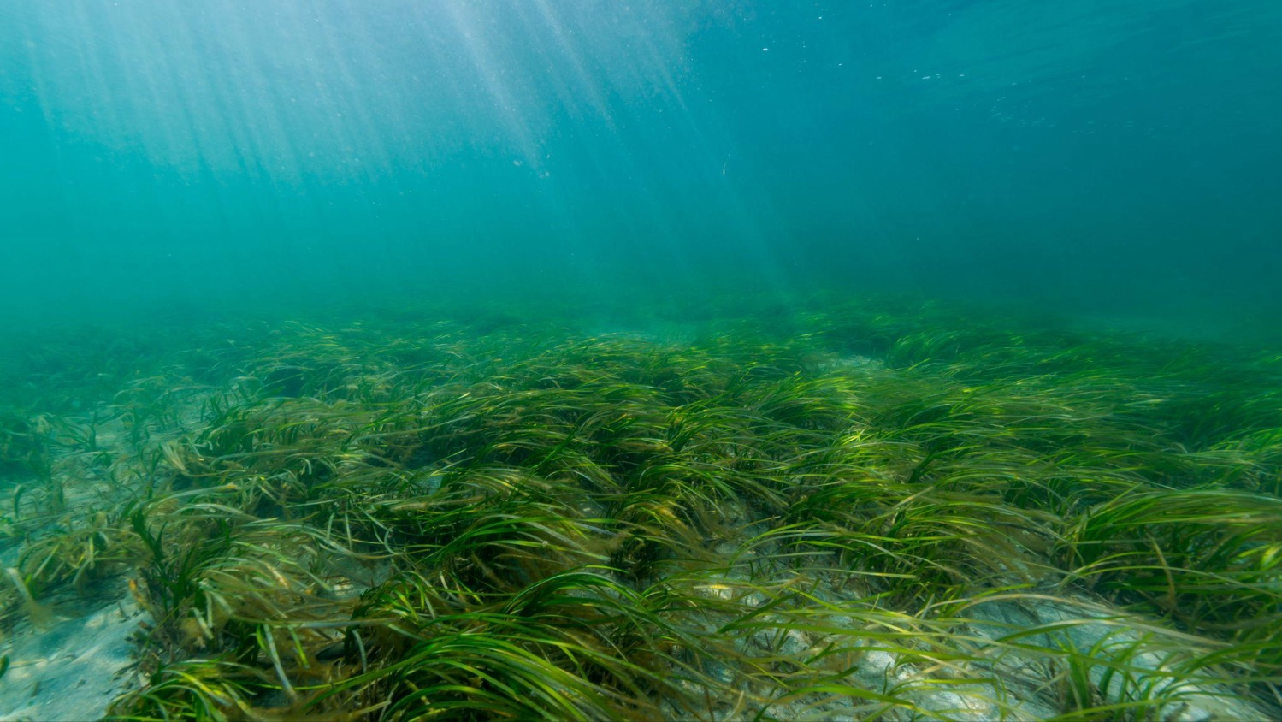







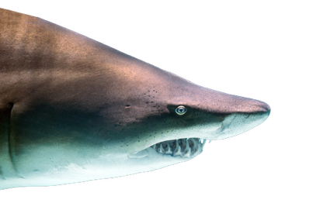

New Series!
• Lexiles: 370L-470L
• Science & nature
• Ocean habitats
• Answers all of young readers’
questions about sharks
READING LEVEL: Gr. 1
INTEREST LEVEL: Gr. K-1

Slide 5
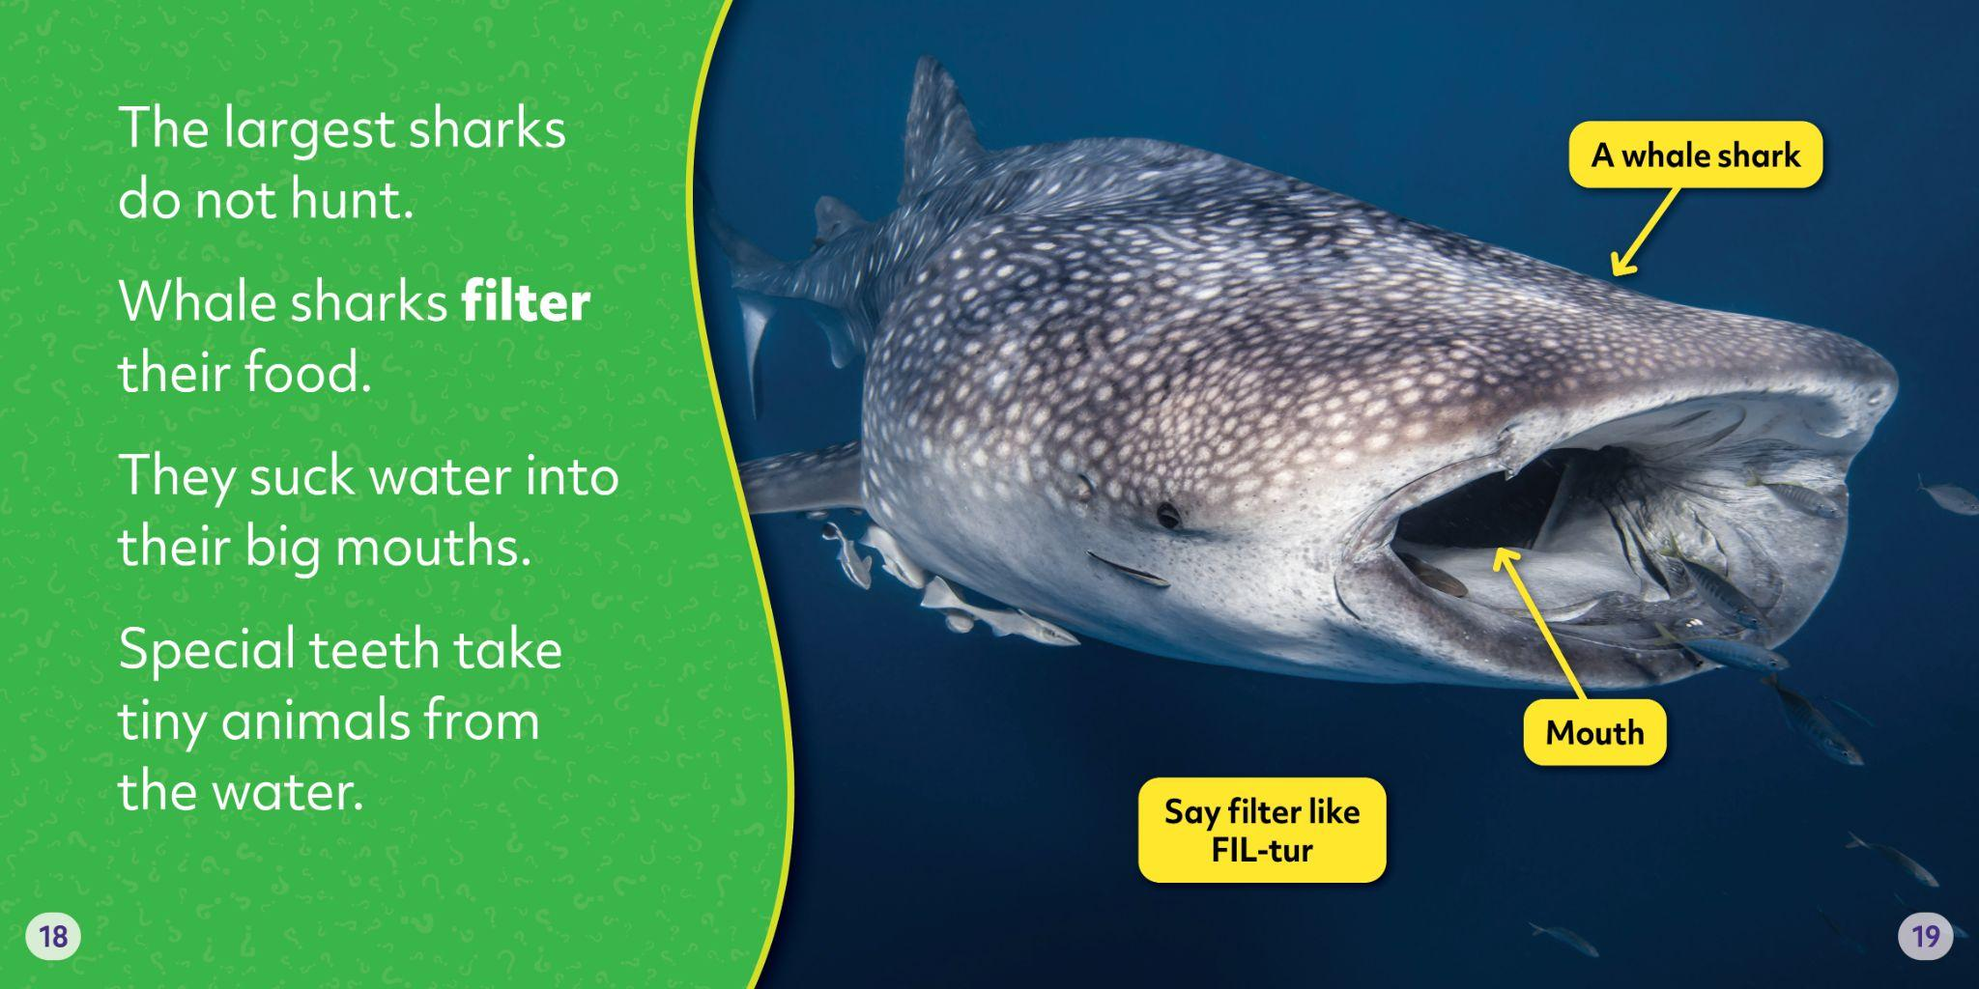

Slide 6
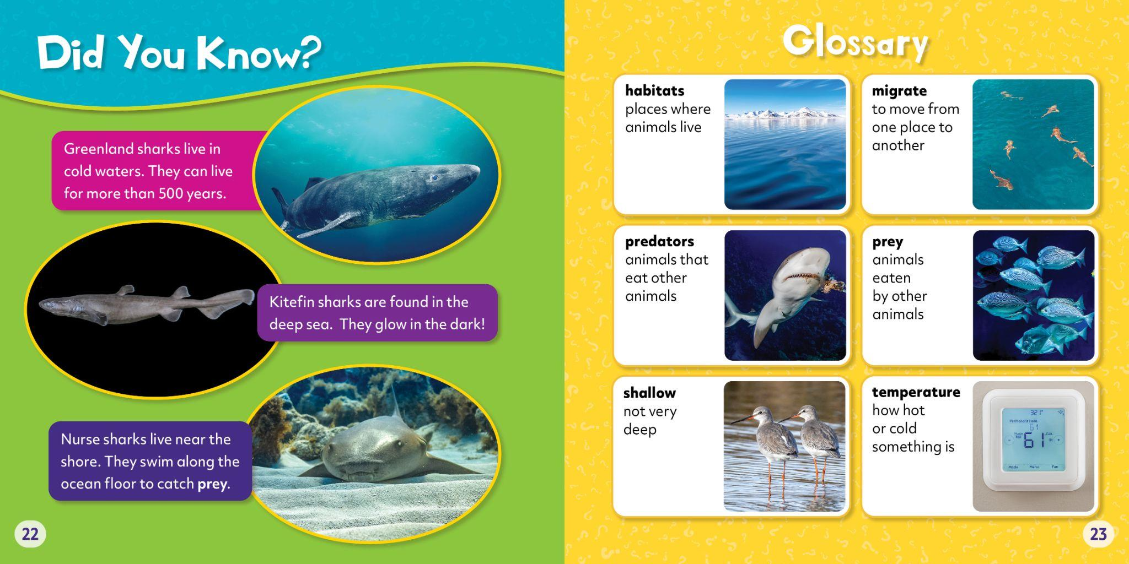

Slide 7








6 New Titles!
• Lexiles: 400L-440L
• Formerly Bearcub Bios, there
are 23 more titles in this series
• Explores the stories of some of
today’s biggest stars
• Examples of how stars use their
fame to make positive changes
READING LEVEL: Gr. 1
INTEREST LEVEL: Gr. K-1

Slide 8
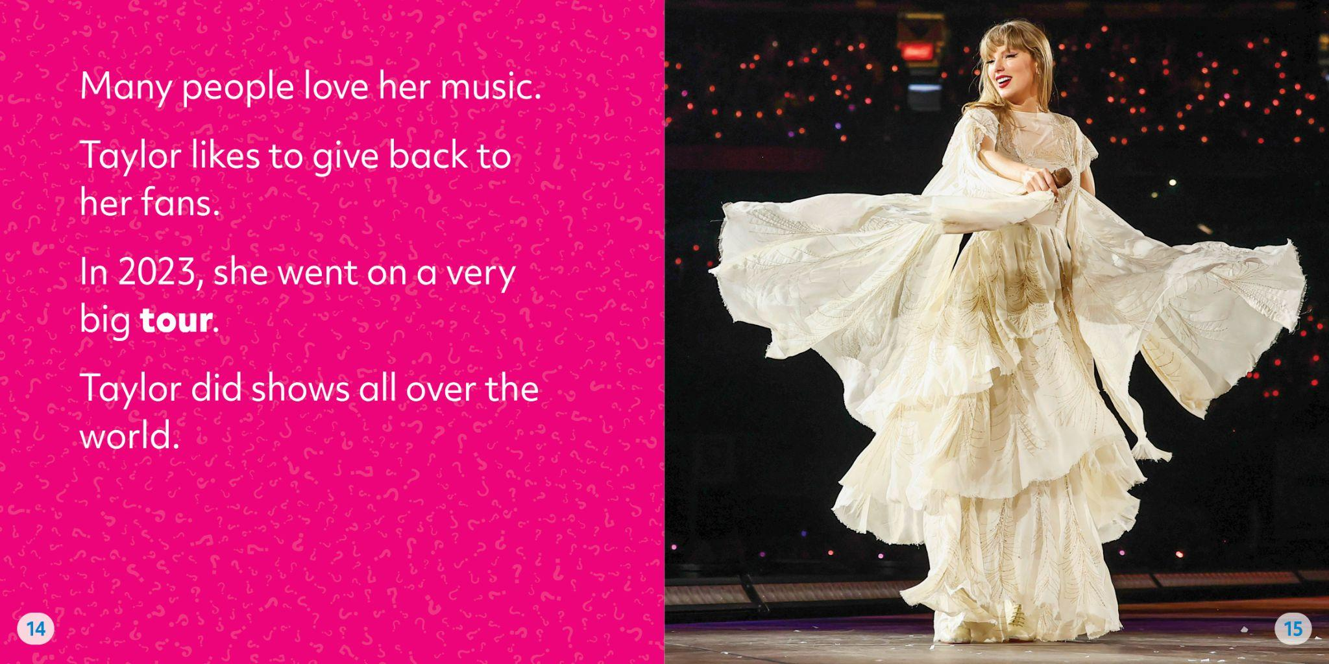

Slide 9
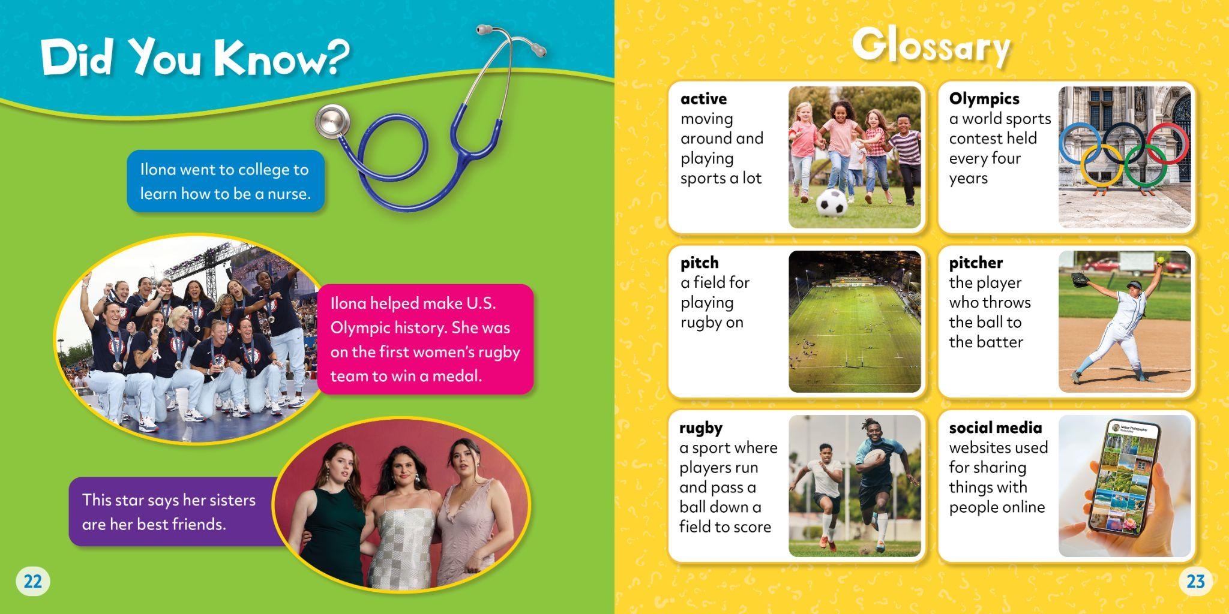

Slide 10










New
Series!
• ATOS coming soon!
• Lexiles: 370L-480L
• Answers the big questions about farm machines that readers ask
• Covers the roles each machine plays
• Photos with labels of machine
parts & pronunciations
READING LEVEL: Gr. 1
INTEREST LEVEL: Gr. K-1

Slide 11
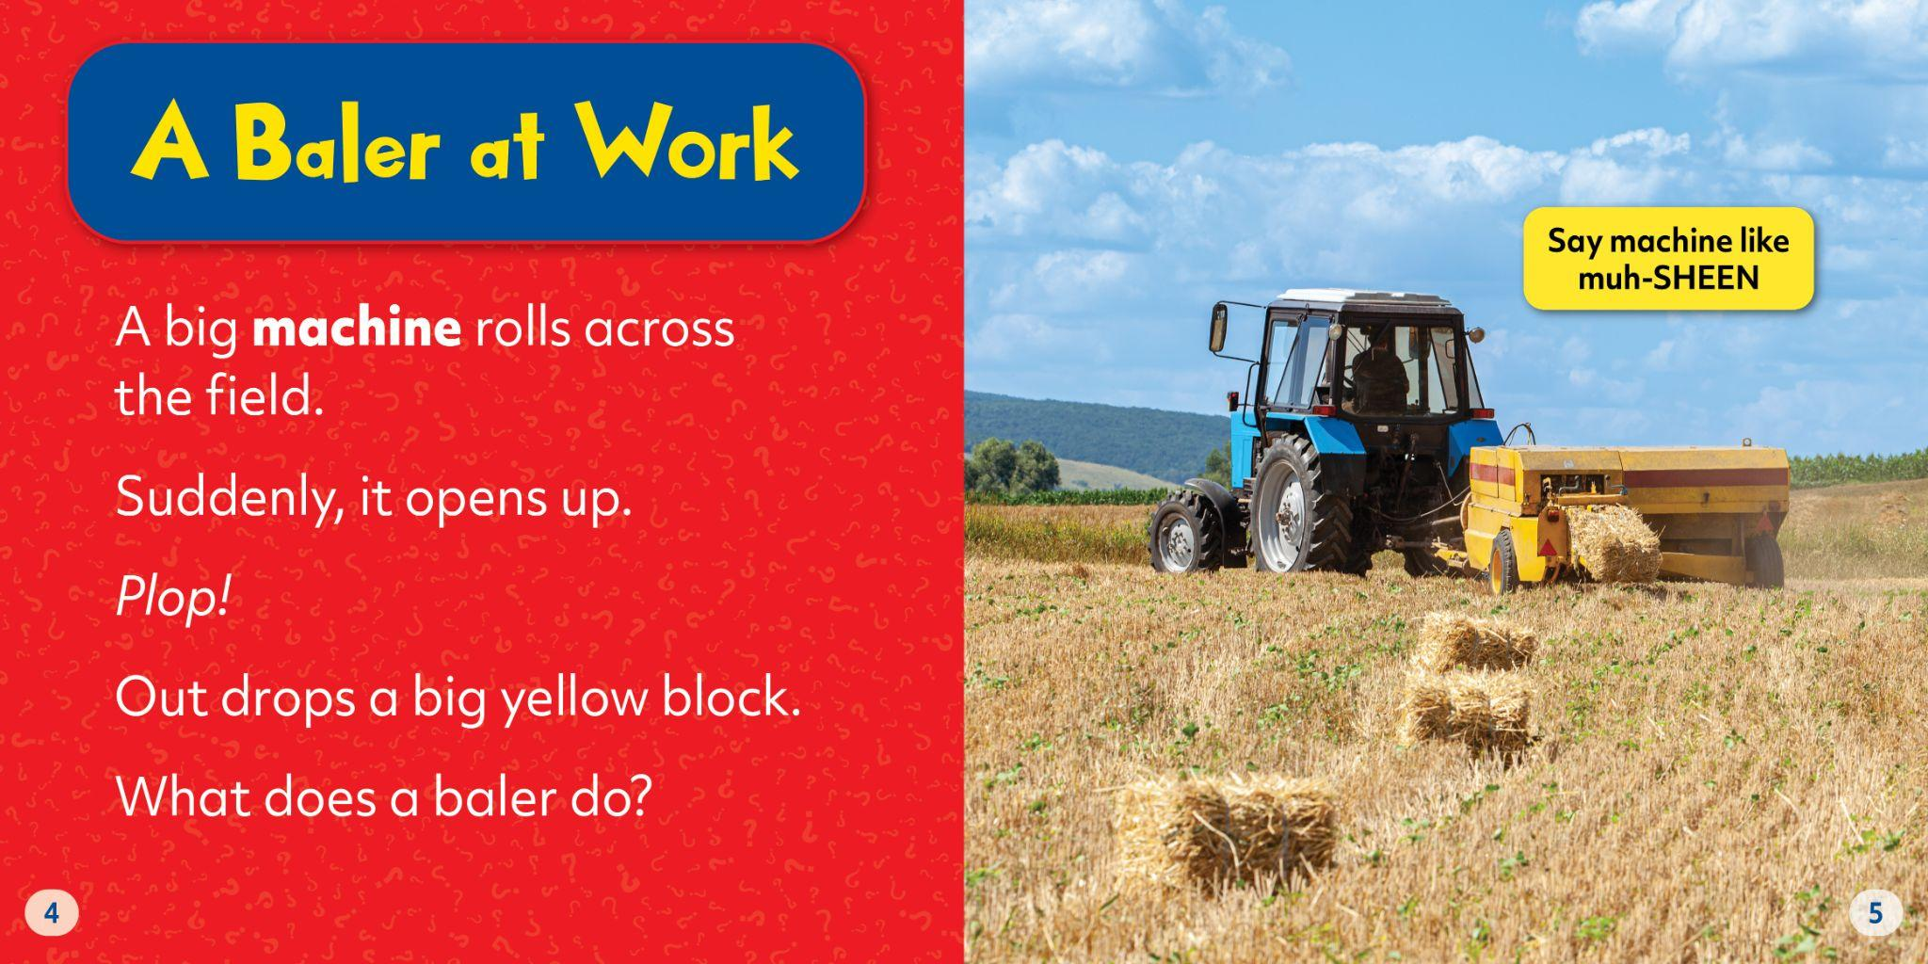

Slide 12
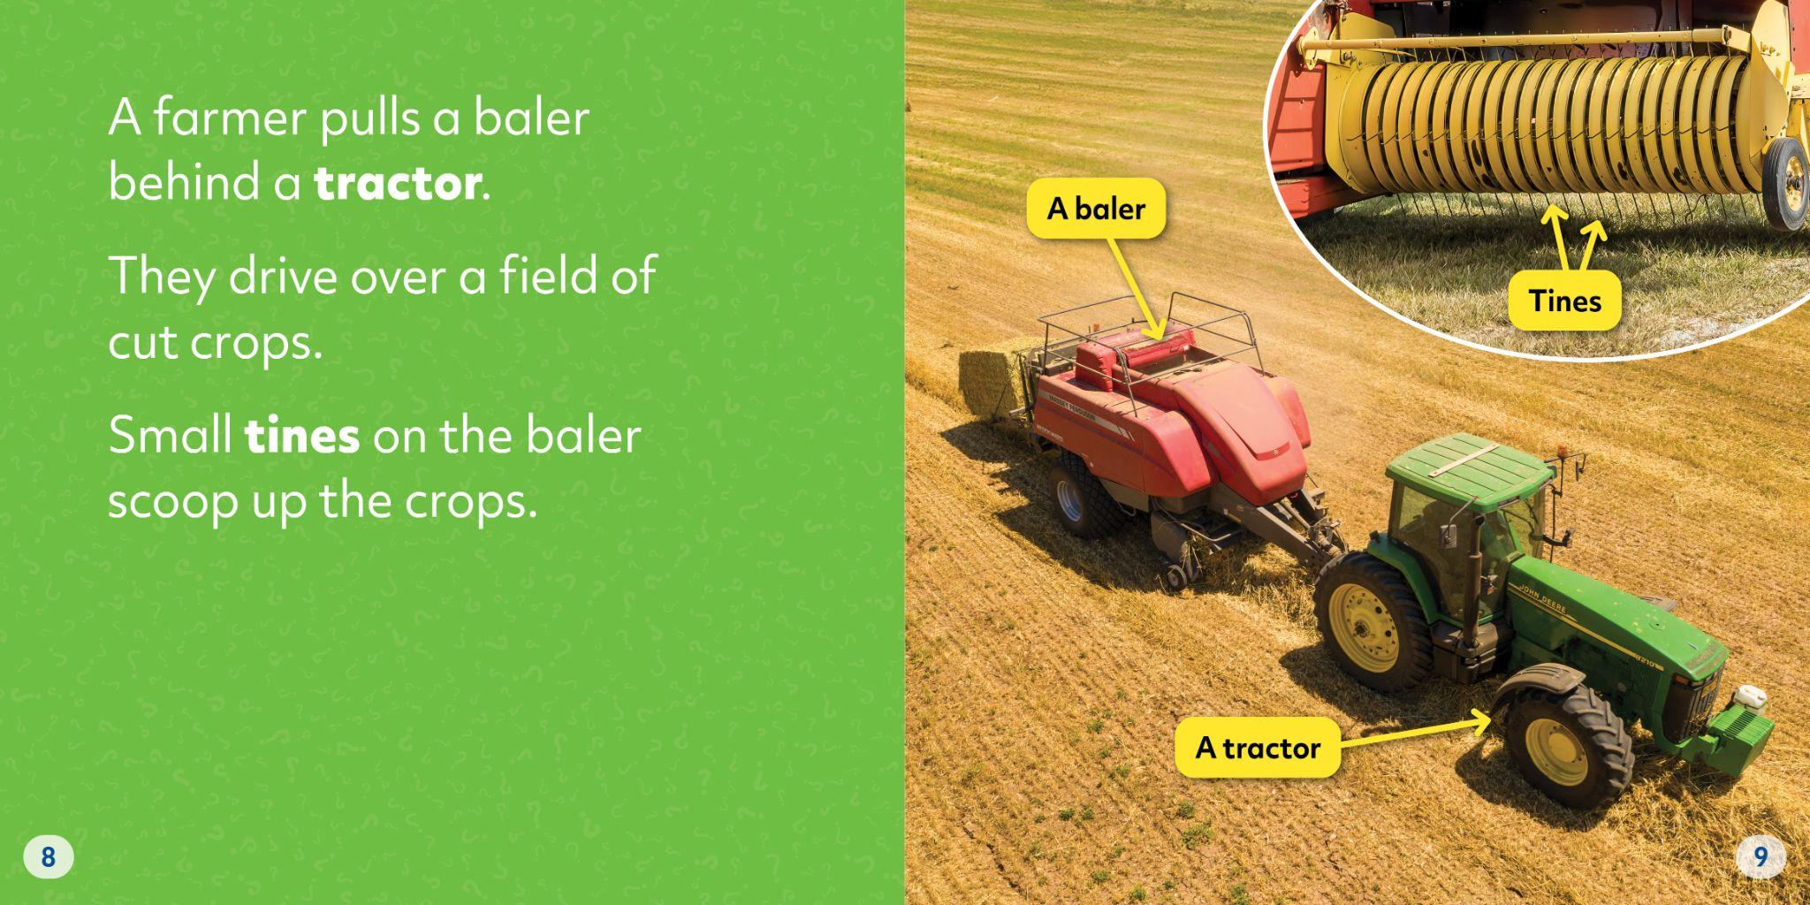

Slide 13
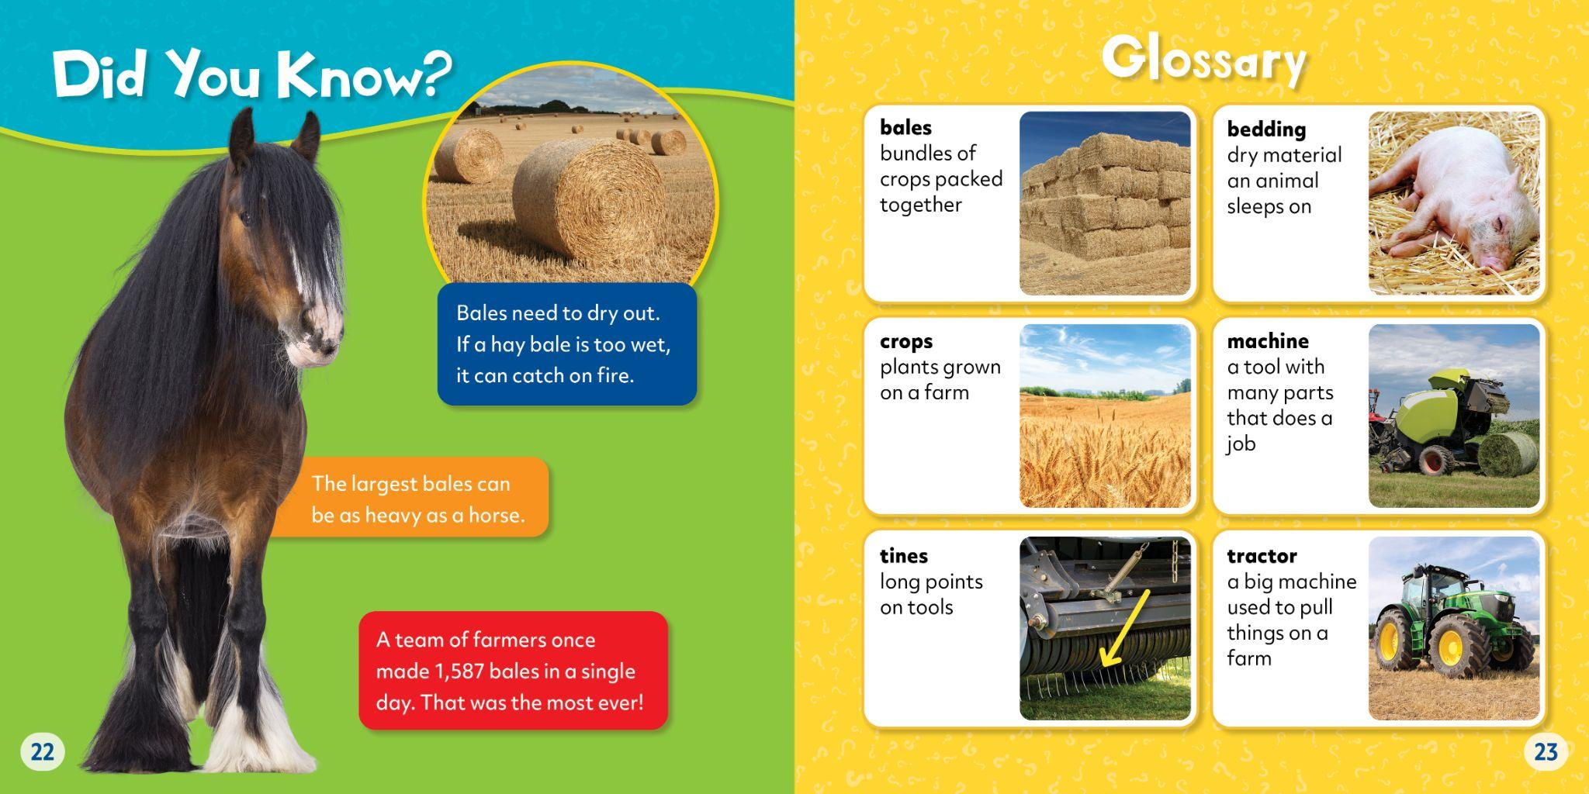

Slide 14






New
Series!
• Lexiles: 360L-400L
• Introduces time
measurement concepts
• Helps young readers develop
awareness of time in their daily schedules
• Real-life skills, made
approachable
• Invites readers to consider
examples of time-telling in their own lives
READING LEVEL: Gr. 1
INTEREST LEVEL: Gr. K-1

Slide 15
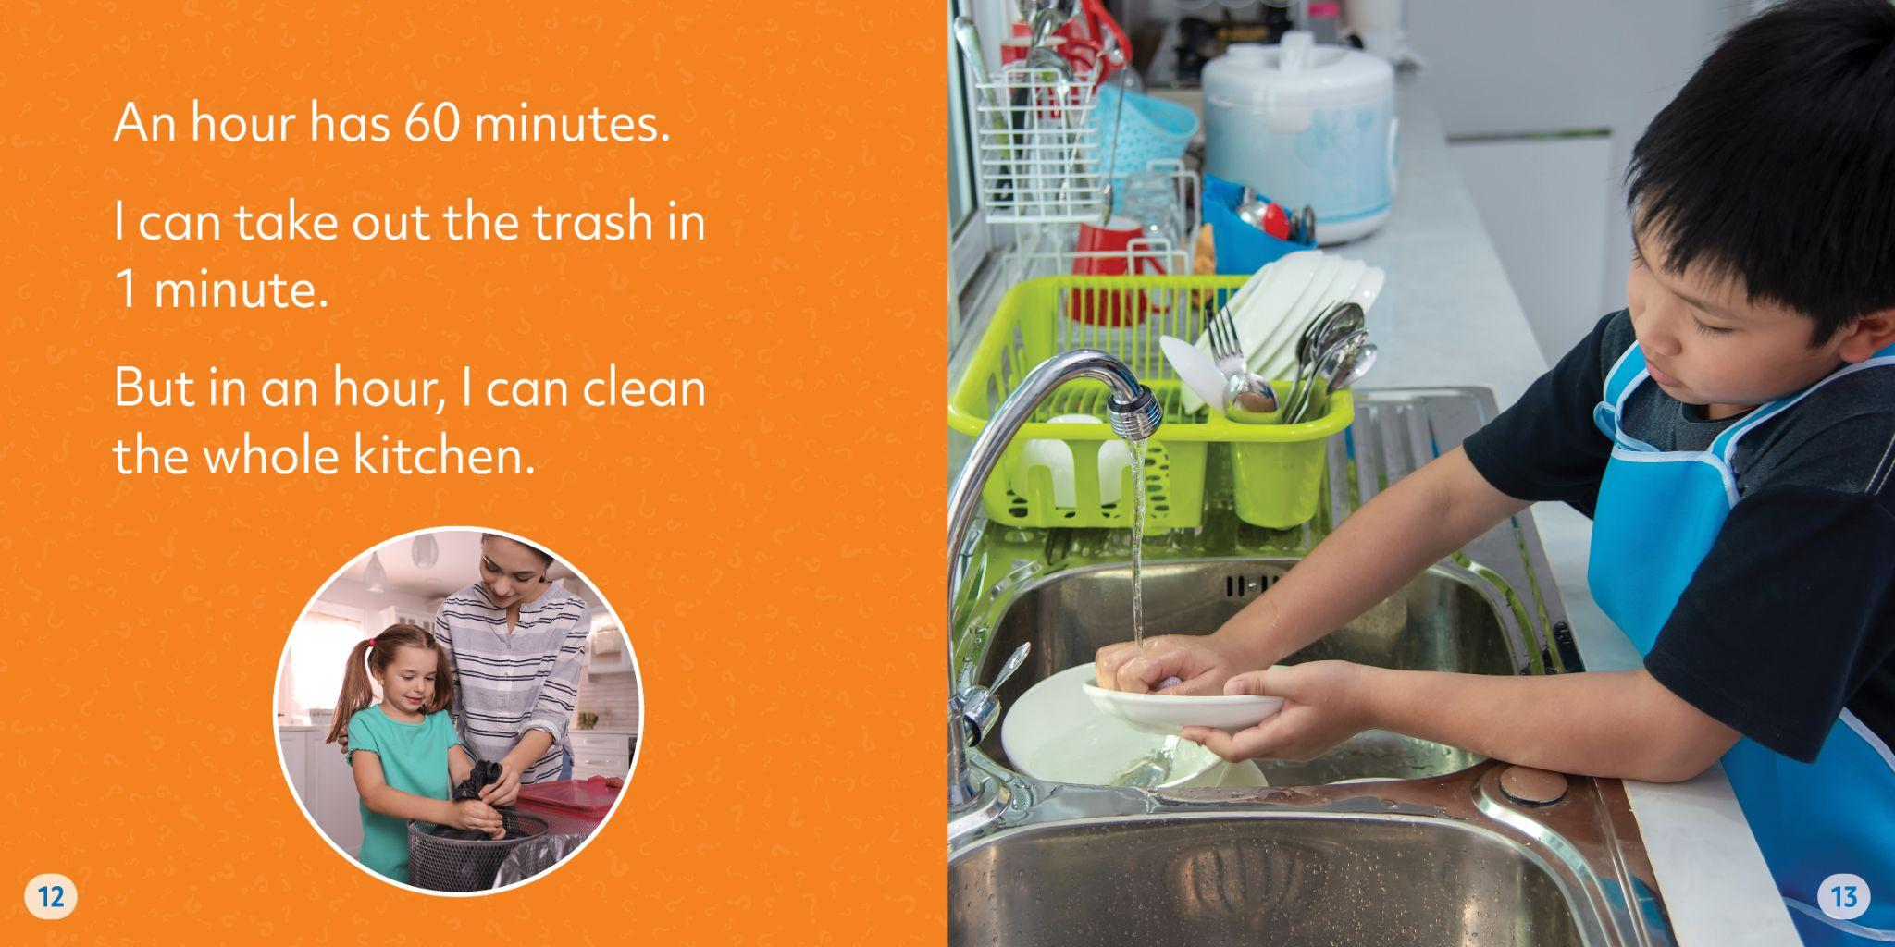

Slide 16
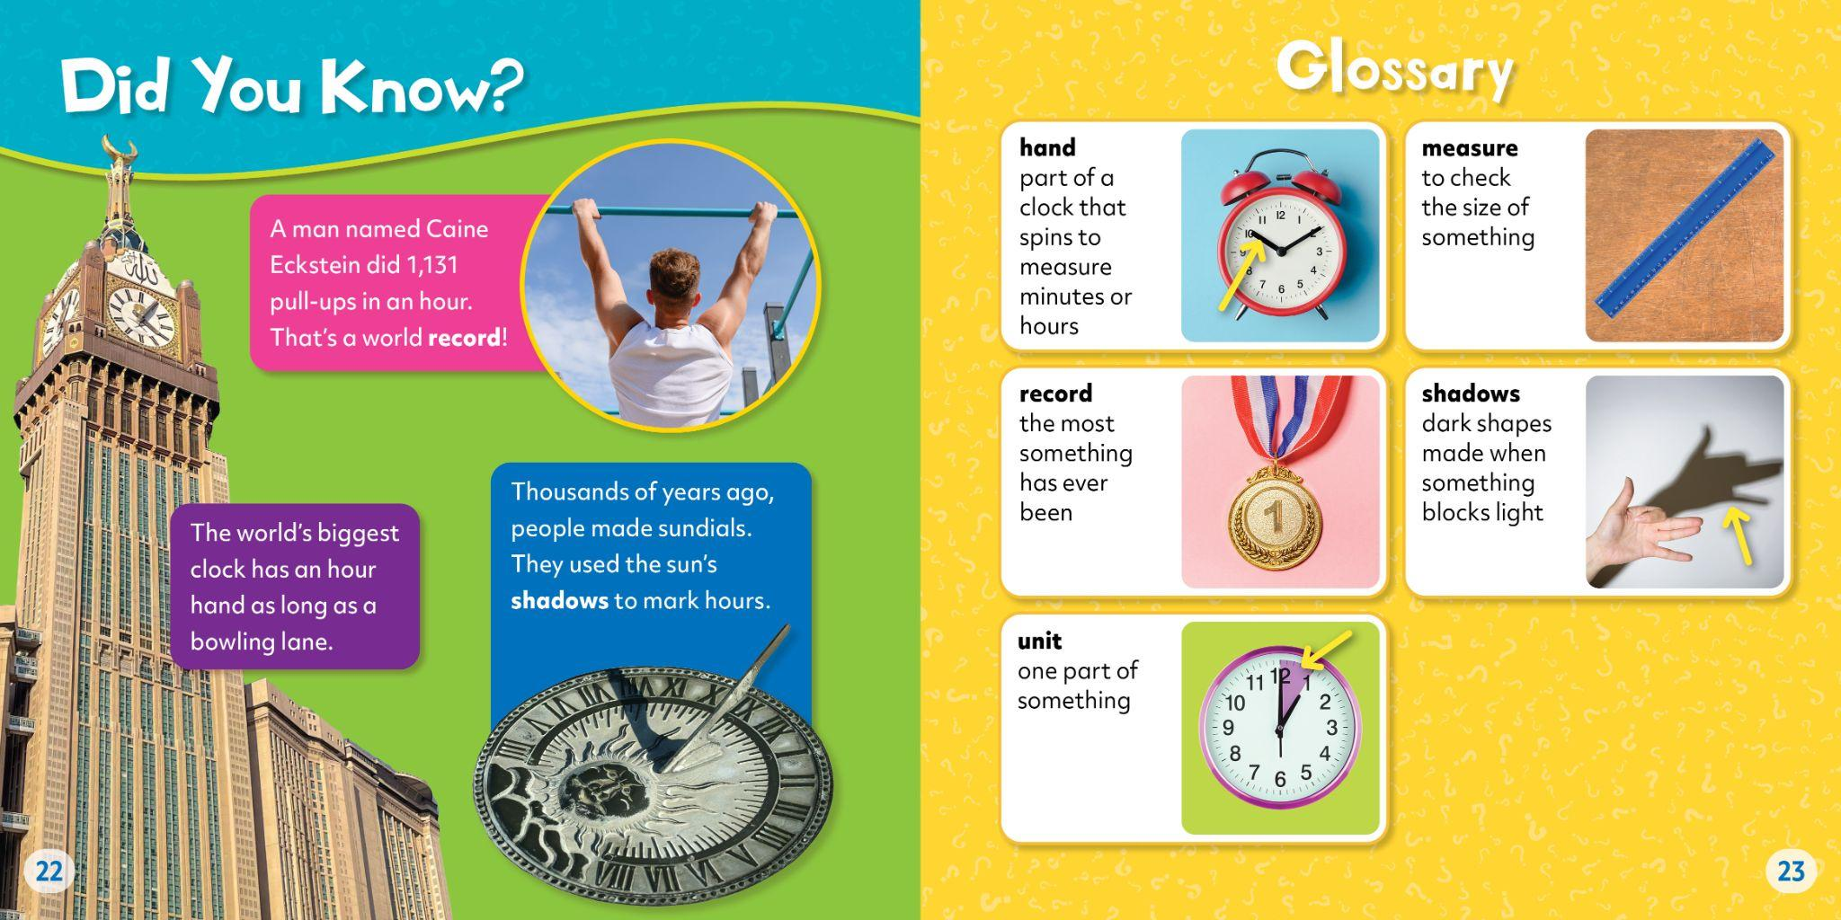

Slide 17


FUN, FACTUAL, ENGAGING
Reading Levels: Grades 2-3
Interest Level: Grades 1-3
ATOS Range: 3.0-4.0
Lexile Range: 560-790
Pages: 24
Hardcover: $21.67
Ebook: $19.99
Paperback: $7.99

Slide 18








New Series!
• Lexiles: 590L-670L
• Cheeky text gives fair warning:
stay away from these powerful predators… or else!
• Fun, frightening illustrations
& photos
• Explores animal behavior
& habitats
READING LEVEL: Gr. 2-3
INTEREST LEVEL: Gr. 1-3
Notes:
SERIES COVERS - BELLWETHER

Slide 19
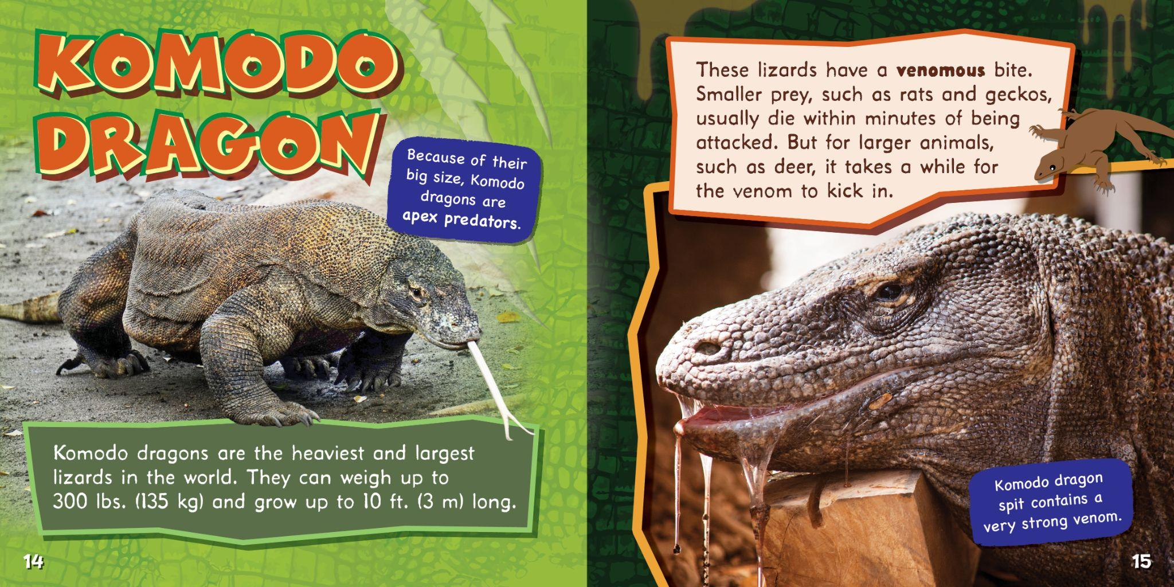
Notes:
SERIES SPREAD 2 - BEARPORT

Slide 20
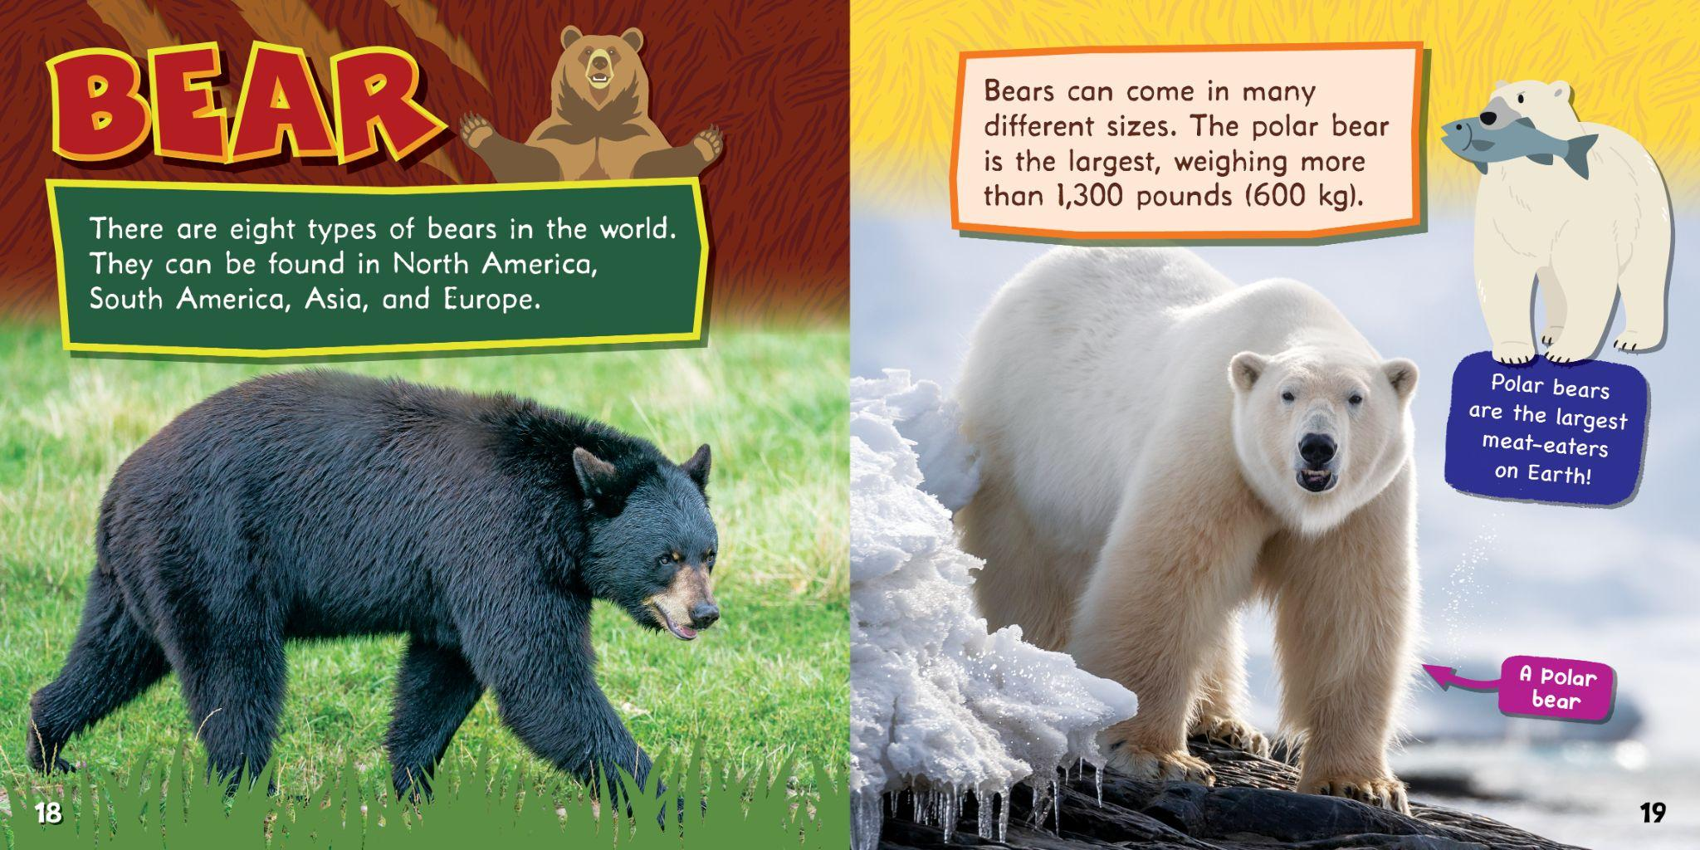
Notes:
SERIES SPREAD 2 - BEARPORT

Slide 21
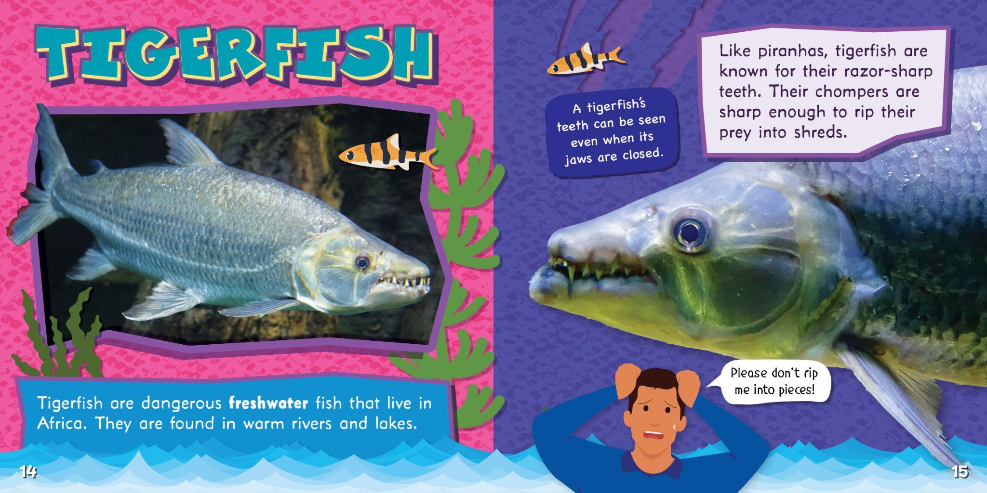
Notes:
SERIES SPREAD 2 - BEARPORT

Slide 22
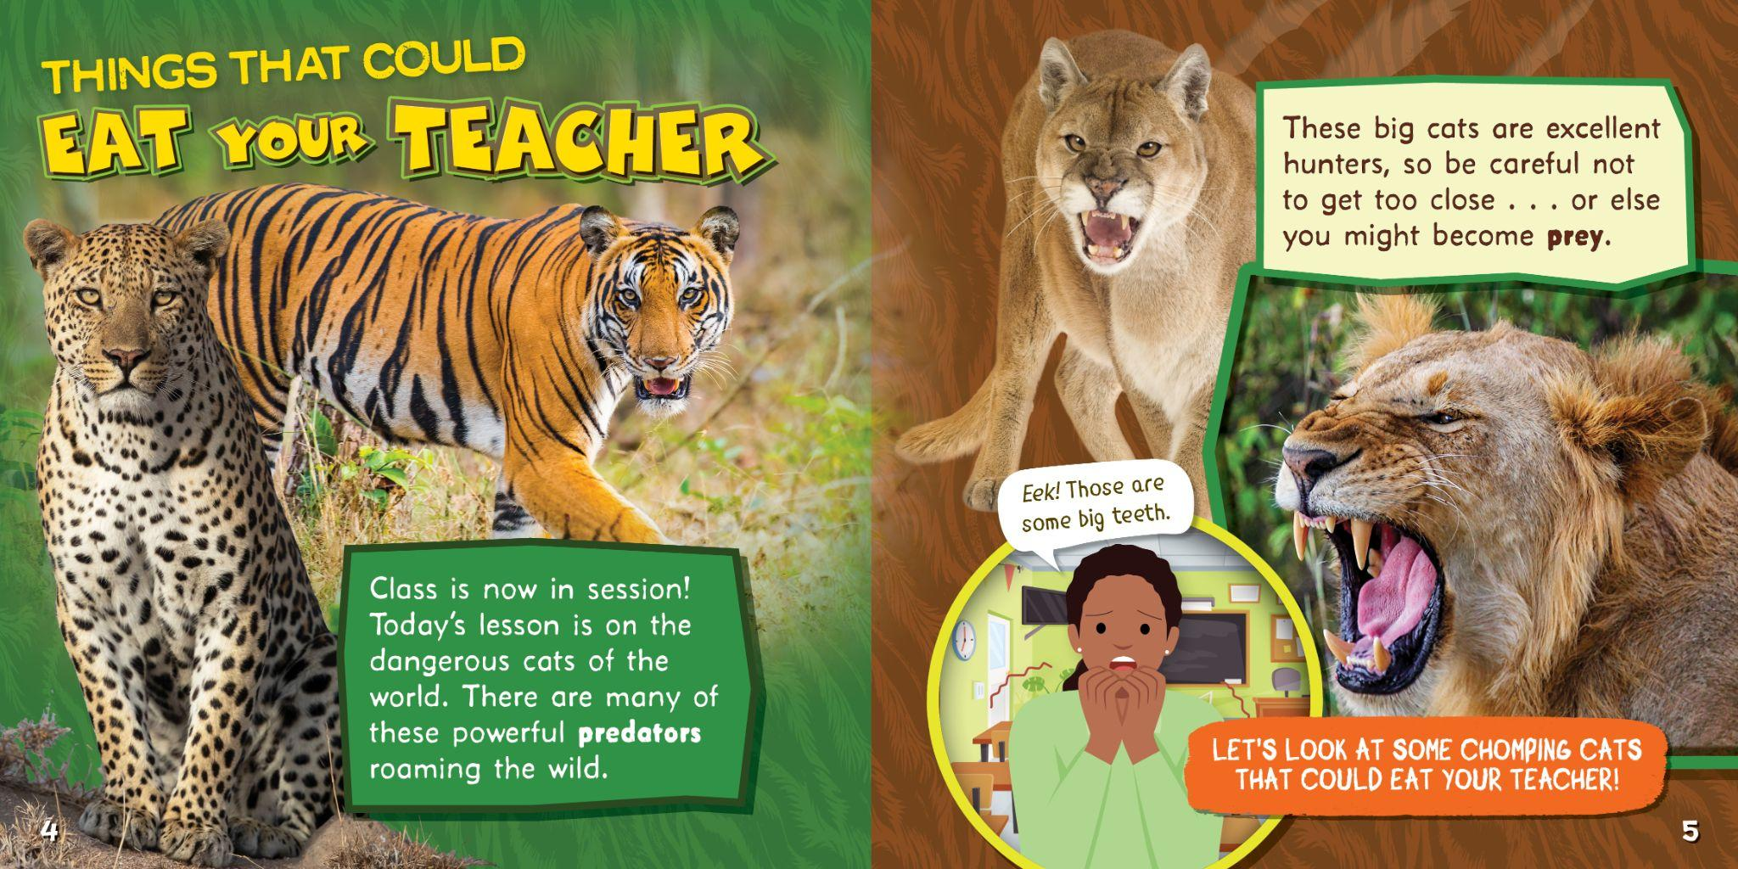
Notes:
SERIES SPREAD 2 - BEARPORT

Slide 23









New Series!
• Lexiles: 570L-740L
• Engaging cat narrator offers
fun commentary
• Approachable early history
content
• Encourages connecting historic
events with modern impact
READING LEVEL: Gr. 2-3
INTEREST LEVEL: Gr. 1-3
Notes:
SERIES COVERS - BELLWETHER

Slide 24

Notes:
SERIES SPREAD 2 - BEARPORT

Slide 25







New Series!
• Lexiles: 610L-700L
• Hands-on activities
• Practical skills advice
• Mini inspirational bios
• “Did You Know” fun facts
READING LEVEL: Gr. 2-3
INTEREST LEVEL: Gr. 1-3
Notes:
SERIES COVERS - BELLWETHER

Slide 26

Notes:
SERIES SPREAD 2 - BEARPORT

Slide 27

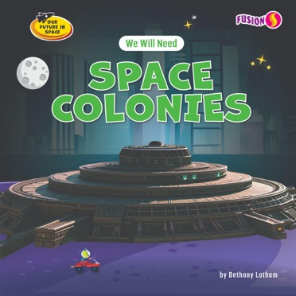





New Series!
• ATOS coming soon!
• Lexiles: 610L-680L
• Engaging space photos & fun
illustrations
• Fun alien character prompts further
consideration & discussion
• Written imagining a future
in space
READING LEVEL: Gr. 2-3
INTEREST LEVEL: Gr. 1-3
Notes:
SERIES COVERS - BELLWETHER

Slide 28
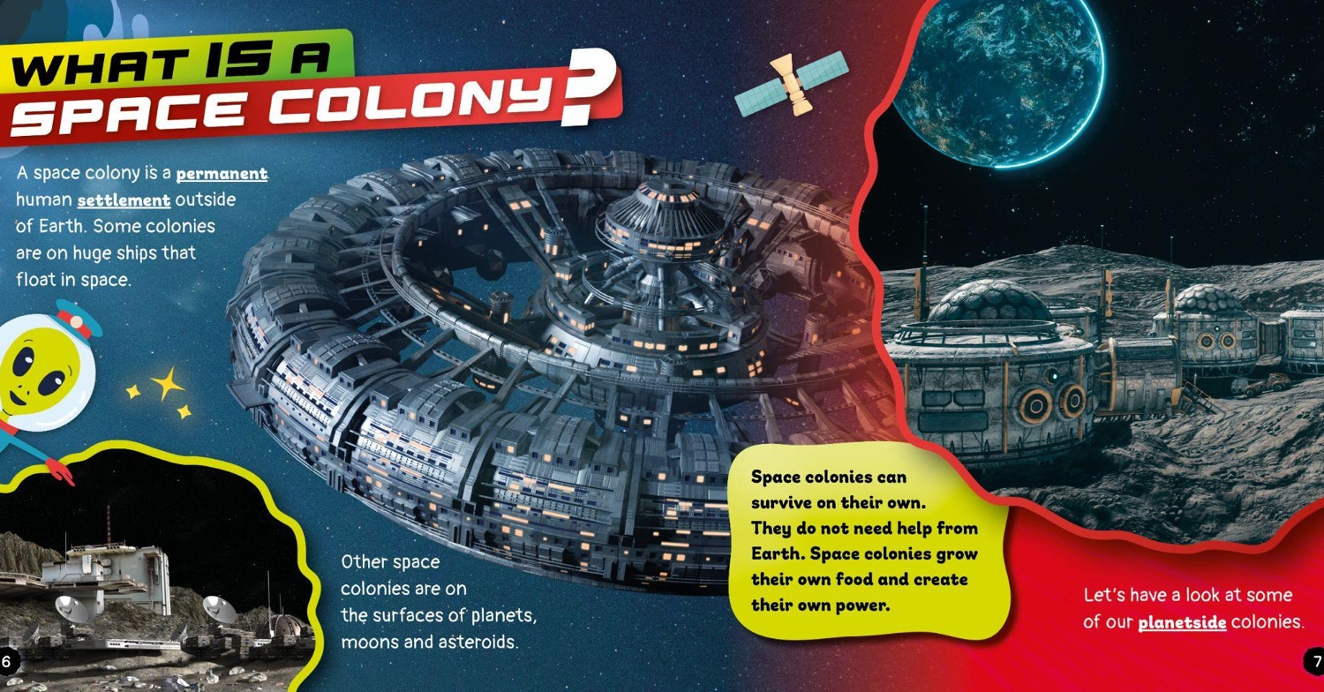
Notes:
SERIES SPREAD 2 - BEARPORT

Slide 29













New Series!
• Lexiles: 600L-650L
• 10 Top Tips in each book
• Practical advice for everyday
challenges
• Age-appropriate text for
developing early life skills
READING LEVEL: Gr. 2-3
INTEREST LEVEL: Gr. 1-3
Notes:
SERIES COVERS - BELLWETHER

Slide 30

Notes:
SERIES SPREAD 2 - BEARPORT

Slide 31



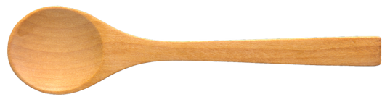

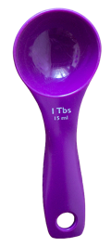
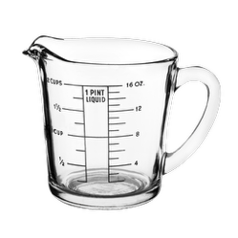

HANDS-ON MAKERSPACE
Reading Level: Grade 3
Interest Level: Grades 2-5
Lexile Range: 820-900
Pages: 24
Hardcover: $23.07
Ebook: $19.99
Notes:
IMPRINT INTRO - BELLWETHER

Slide 32











New Series!
• Lexile: 820L-890L
• Simple, step-by-step
instructions
• Covers cooking basics &
kitchen safety tips
• Alerts for common allergens
READING LEVEL: Gr. 3
INTEREST LEVEL: Gr. 2-5
Notes:
SERIES COVERS - BELLWETHER

Slide 33
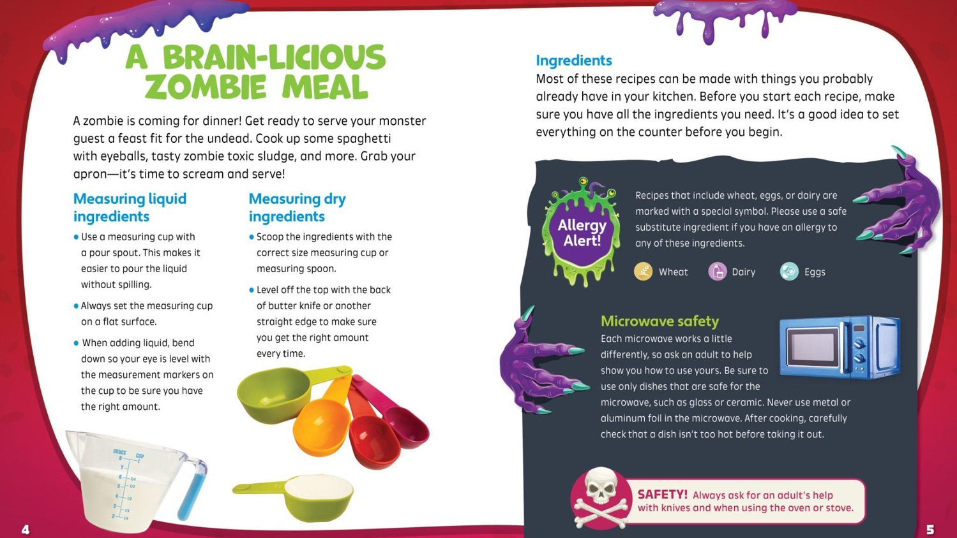
Notes:
SERIES SPREAD 2 - BEARPORT

Slide 34

WHERE CURIOSITY MEETS CONFIDENCE
Reading Level: Grade 3-4
Interest Level: Grades 2-5
ATOS Range: 3.5-6.5
Lexile Range: 590-1010
Pages: 24-32
Hardcover: $21.67-$23.07
Ebook: $19.99
Paperback: $7.99
Notes:
IMPRINT INTRO - BELLWETHER

Slide 35








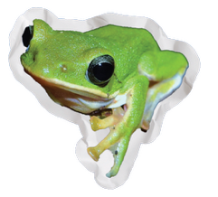

New Series!
• Lexiles: 640L-790L
• Listicle structure
• Jam-packed with fascinating
facts that are highly repeatable
• Fun, photo-collage design
READING LEVEL: Gr. 4
INTEREST LEVEL: Gr. 2-5
Notes:
SERIES COVERS - BELLWETHER

Slide 36
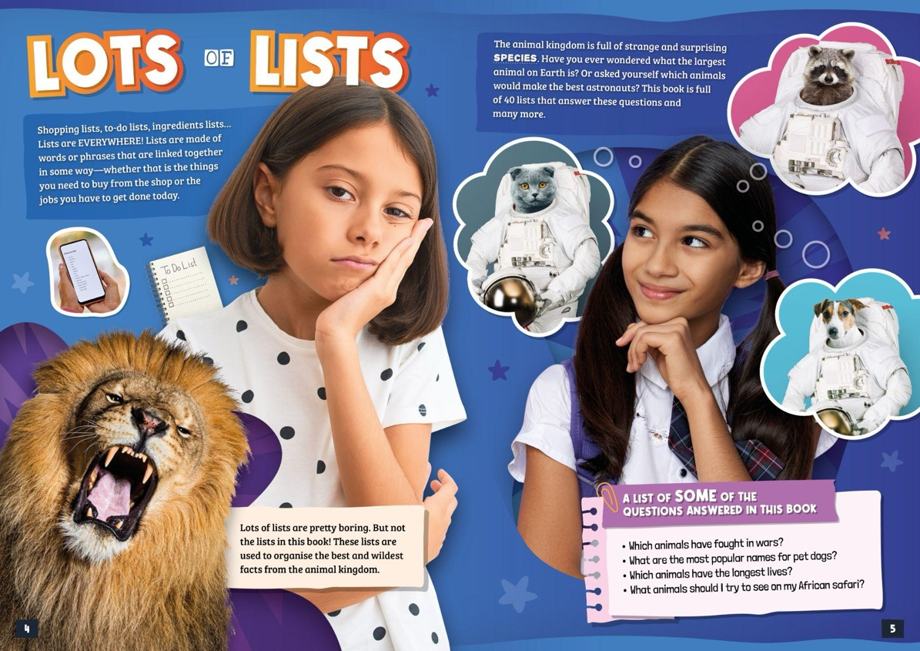
Notes:
SERIES SPREAD 2 - BEARPORT

Slide 37








6 New
Titles!
• Lexiles: 600L-880L
• Detailed range maps
• Infographics showing
size comparison
• Large, full-color
photographs
READING LEVEL: Gr. 3
INTEREST LEVEL: Gr. 2-5
Notes:
SERIES COVERS - BELLWETHER

Slide 38
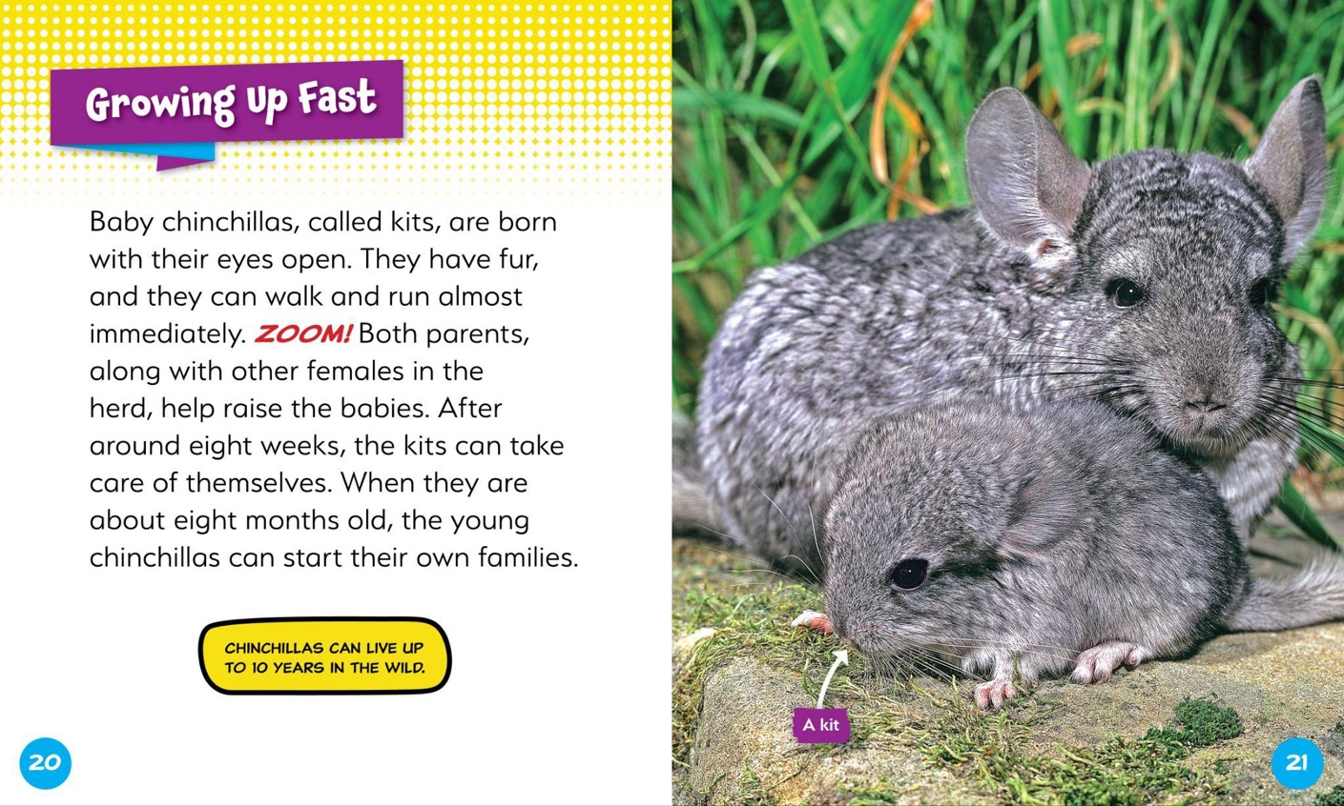
Notes:
SERIES SPREAD 2 - BEARPORT

Slide 39
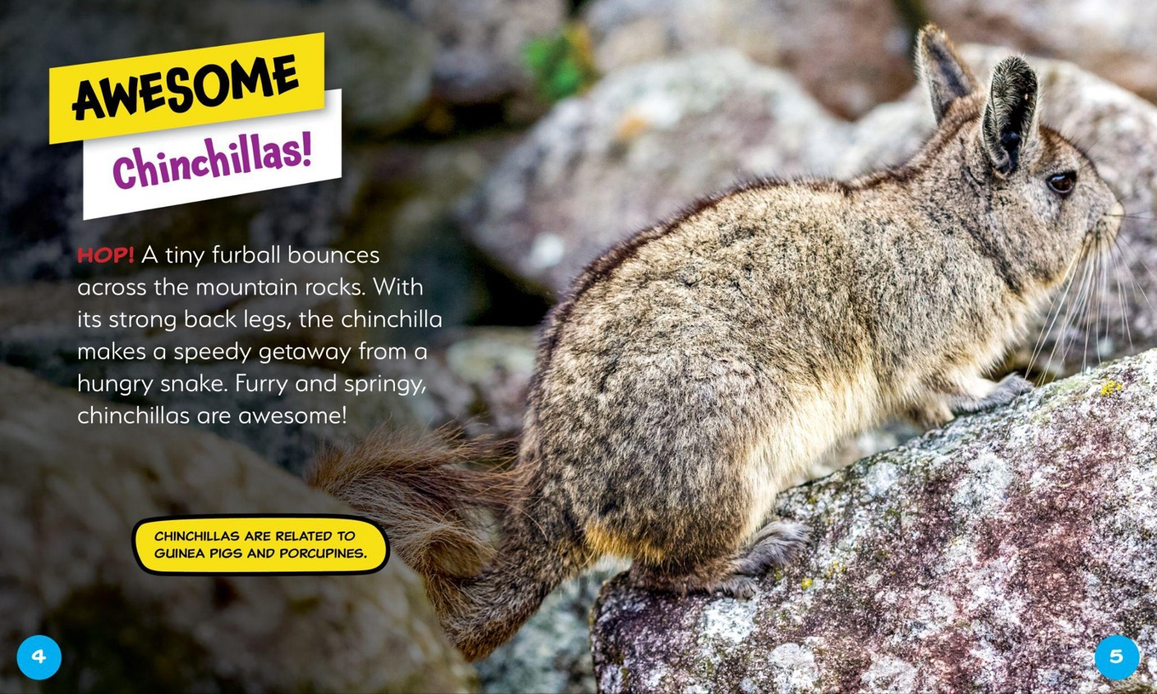
Notes:
SERIES SPREAD 2 - BEARPORT

Slide 40
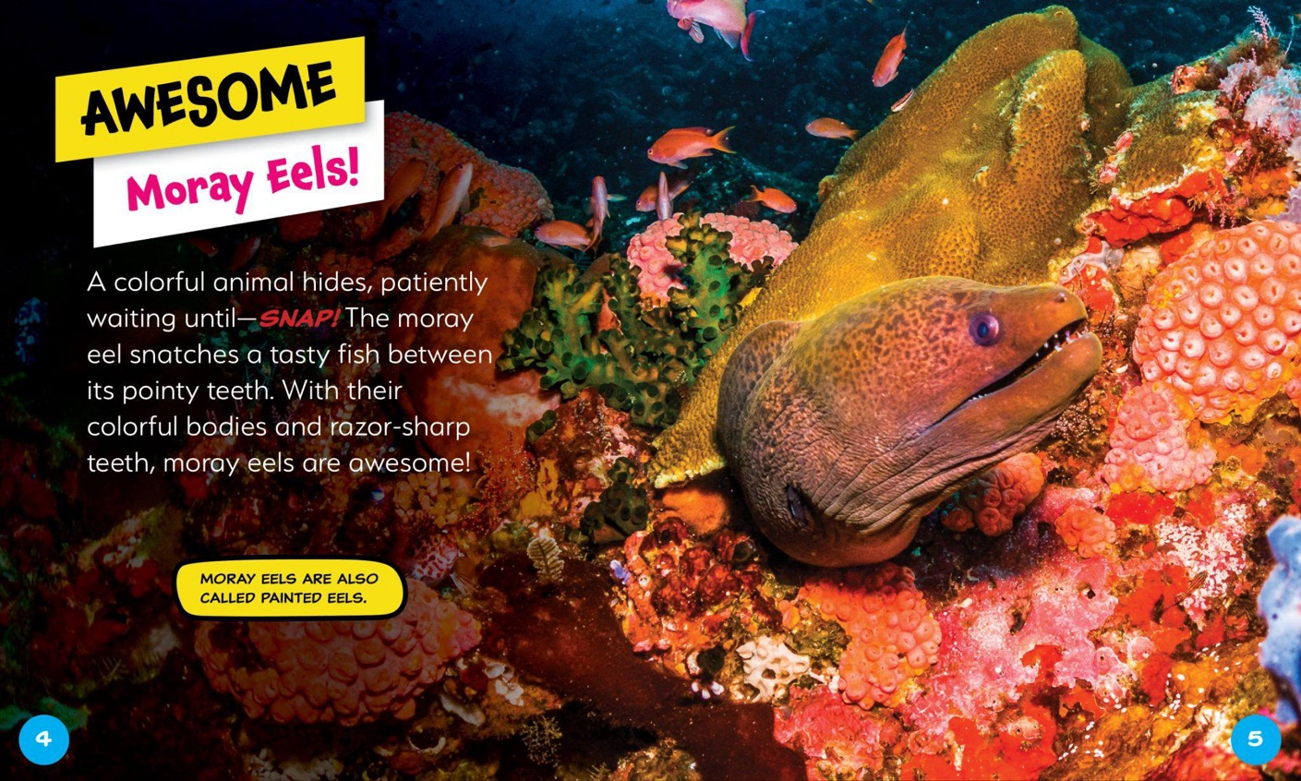
Notes:
SERIES SPREAD 2 - BEARPORT

Slide 41
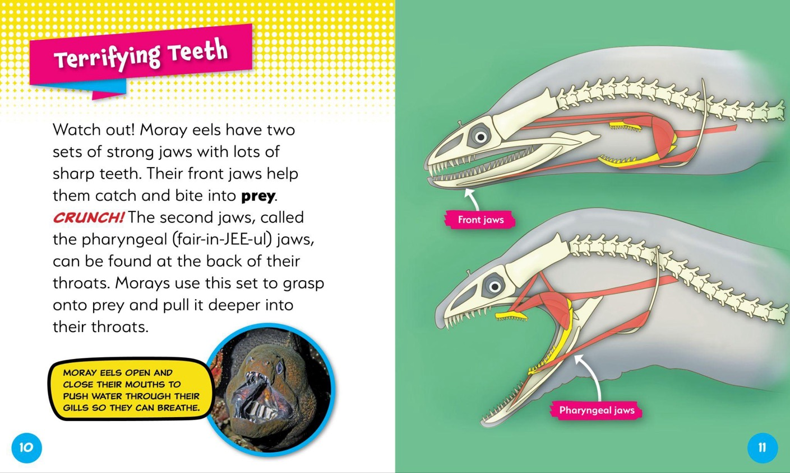
Notes:
SERIES SPREAD 2 - BEARPORT

Slide 42




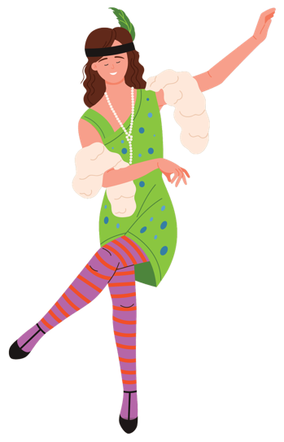


New
Series!
• Lexiles: 660L-800L
• A mix of historic images and
colorful illustrations
• Cheeky speech bubbles bring
levity to the content
• Mini-biographies on style
icons of each era
READING LEVEL: Gr. 3
INTEREST LEVEL: Gr. 2-5
Notes:
SERIES COVERS - BELLWETHER

Slide 43
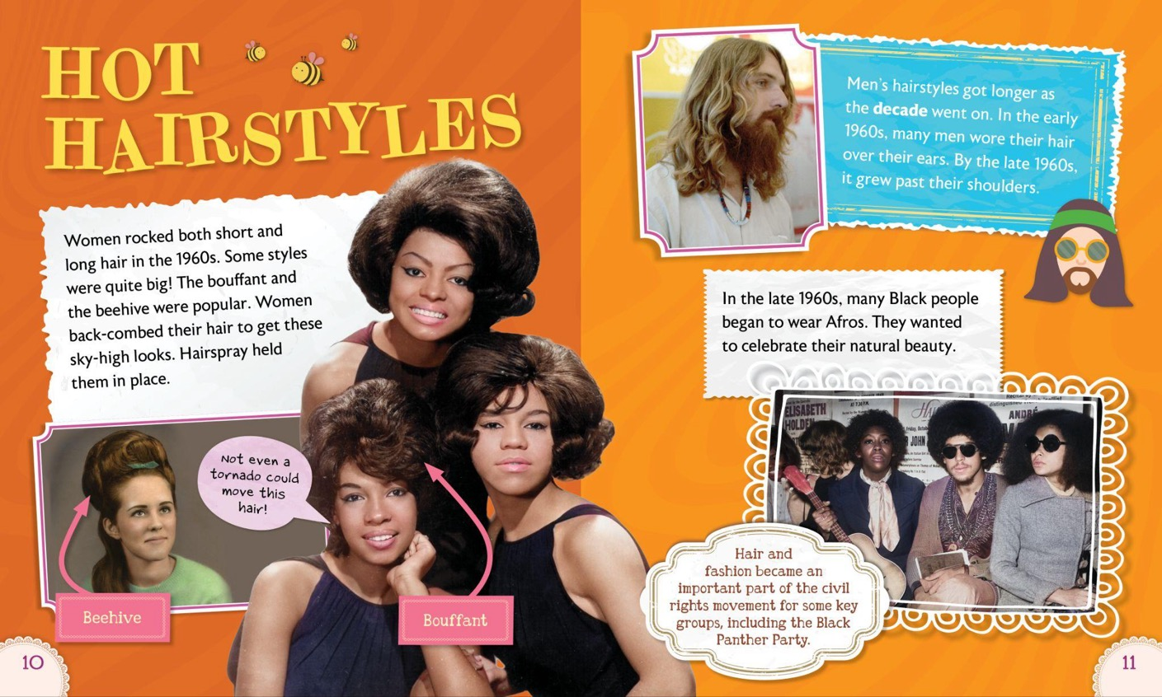
Notes:
SERIES SPREAD 2 - BEARPORT

Slide 44
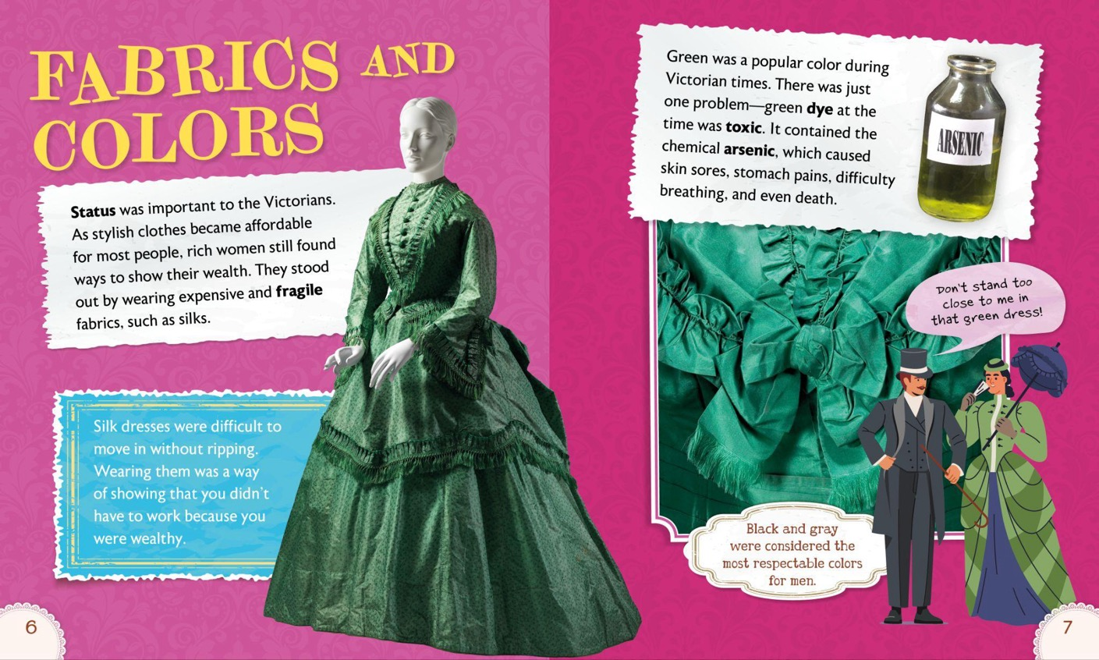
Notes:
SERIES SPREAD 2 - BEARPORT

Slide 45

Notes:
SERIES SPREAD 2 - BEARPORT

Slide 46

Notes:
SERIES SPREAD 2 - BEARPORT

Slide 47
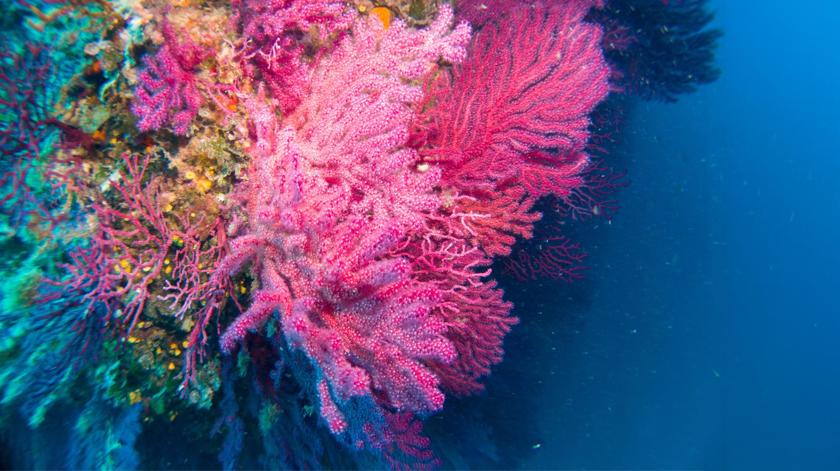








6 New
Titles!
SET
2
• Lexiles: 650L-880L
• Close-up visuals of
captivating sea life
• Highlights unusual traits to
foster curiosity
• Features marine biologists
exploring the title creature
READING LEVEL: Gr. 3
INTEREST LEVEL: Gr. 2-5
Notes:
SERIES COVERS - BELLWETHER

Slide 48
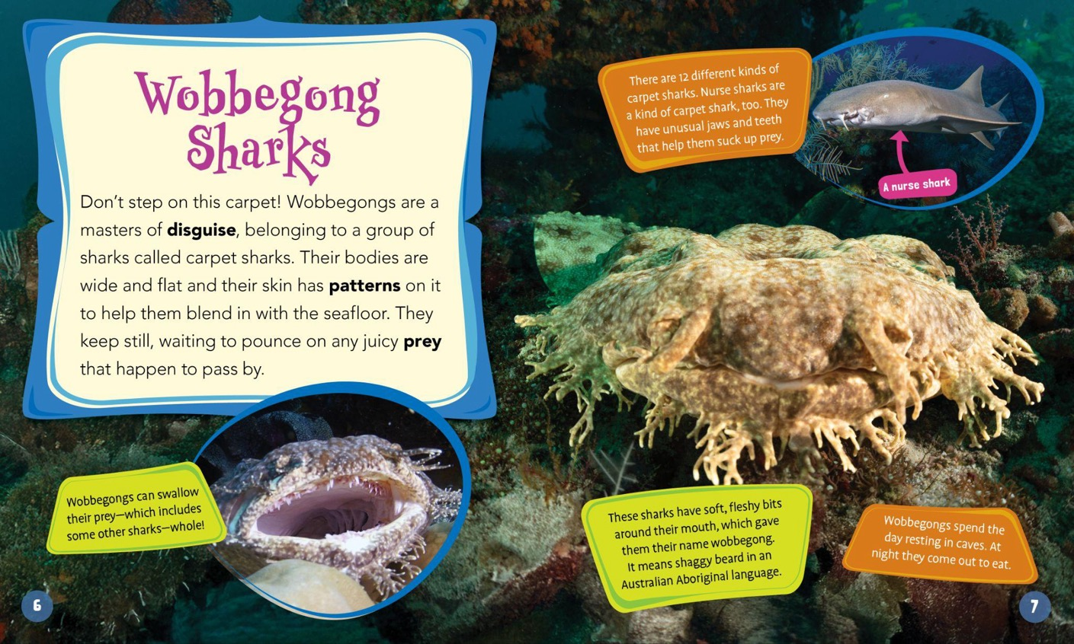
Notes:
SERIES SPREAD 2 - BEARPORT

Slide 49
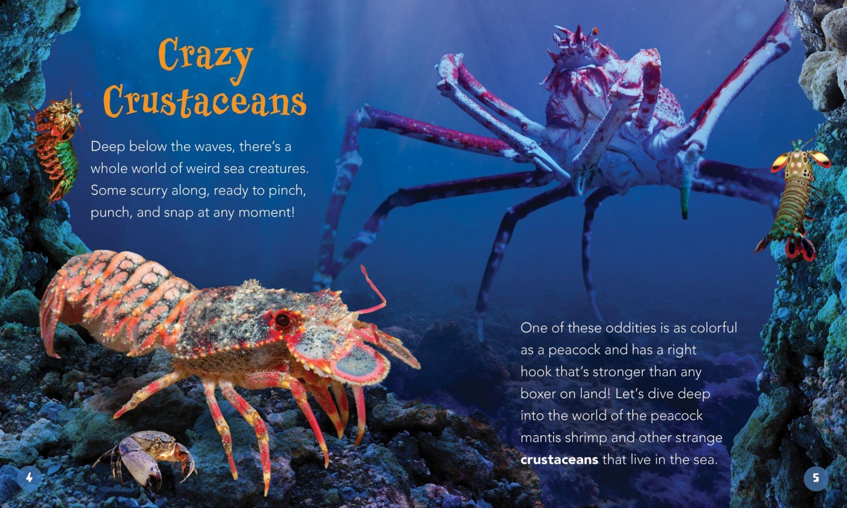
Notes:
SERIES SPREAD 2 - BEARPORT

Slide 50
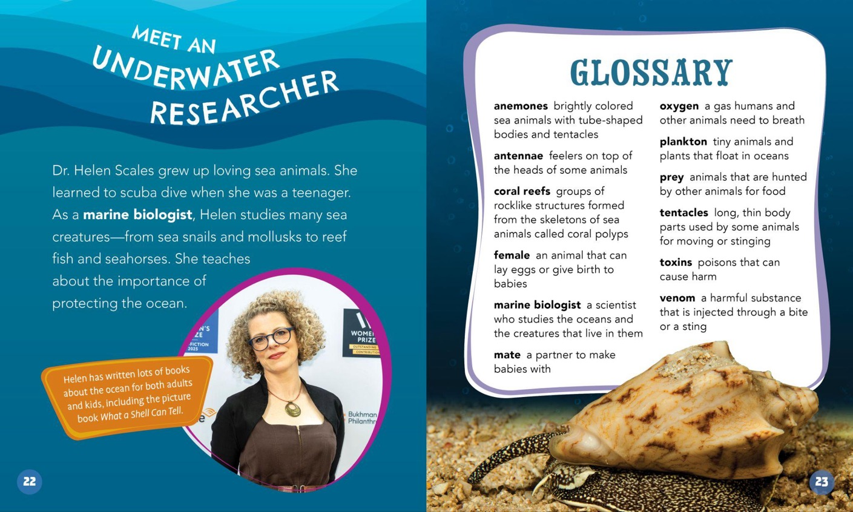
Notes:
SERIES SPREAD 2 - BEARPORT

Slide 51


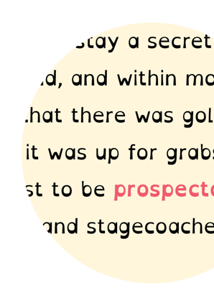

CURRICULAR HI-LO
Dyslexia-friendly font
Review sections & test-taking tips
Reading Level: Grade 3
Interest Level: Grades 5-7
Pages: 32
ATOS Range: 4.5-5.0
Lexile Range: 540-710
Hardcover: $23.07
Ebook: $19.99
Notes:
IMPRINT INTRO - BELLWETHER

Slide 52










READING LEVEL: Gr. 2-3
INTEREST LEVEL: Gr. 5-7
New Series!
• Lexiles: 550L-630L
• Dyslexic-friendly font & design
• Reviewed by specialists in education of
middle school students with learning differences
• Infographics for visual learners
• SilverTips for Success section
for review & test-taking tips
READING LEVEL: Gr. 3
INTEREST LEVEL: Gr. 5-7
Notes:
SERIES COVERS - BELLWETHER

Slide 53
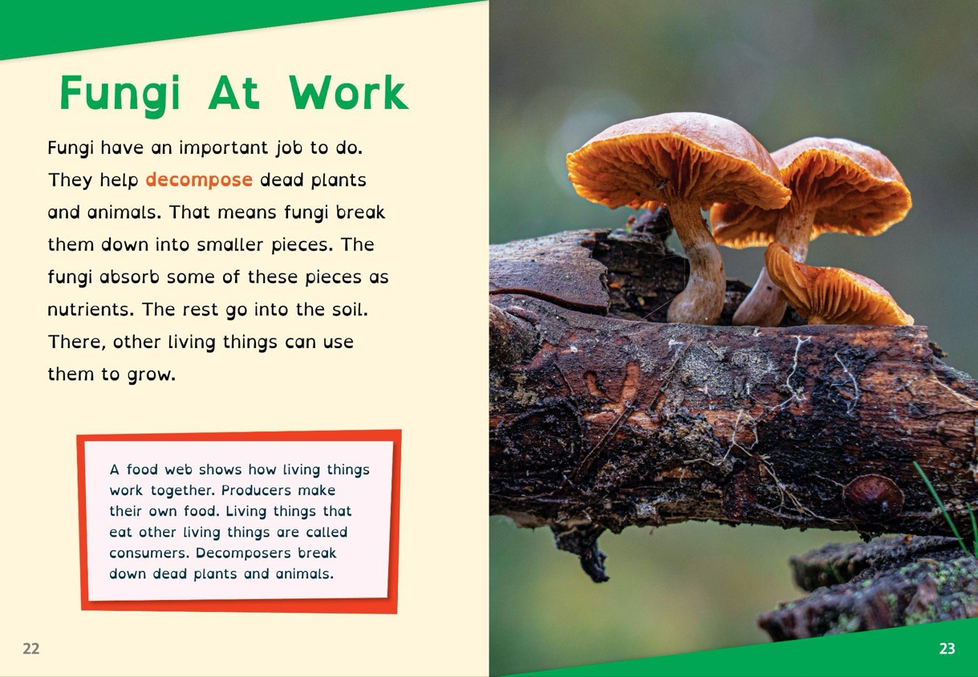
Notes:
SERIES COVERS - BELLWETHER

Slide 54
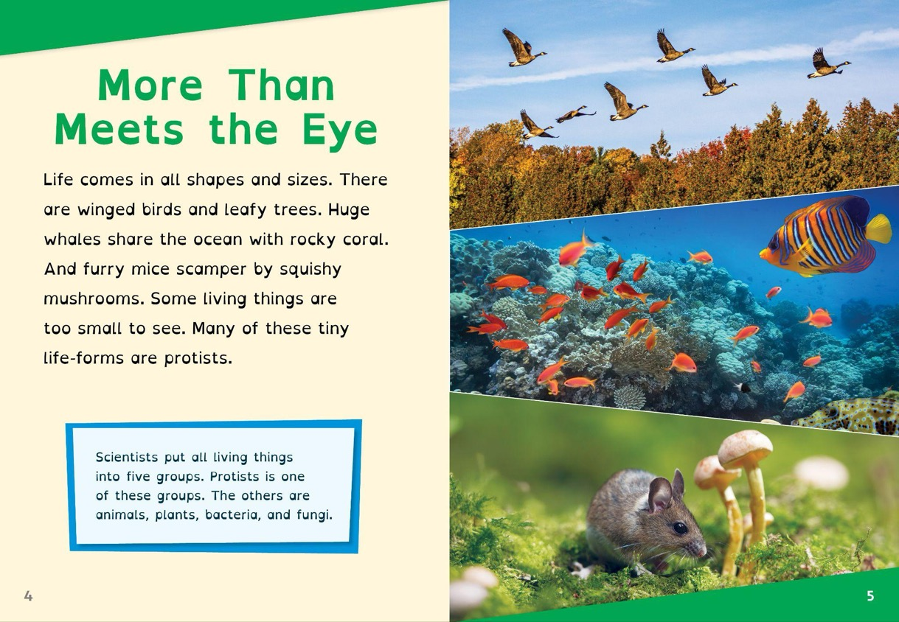
Notes:
SERIES COVERS - BELLWETHER

Slide 55
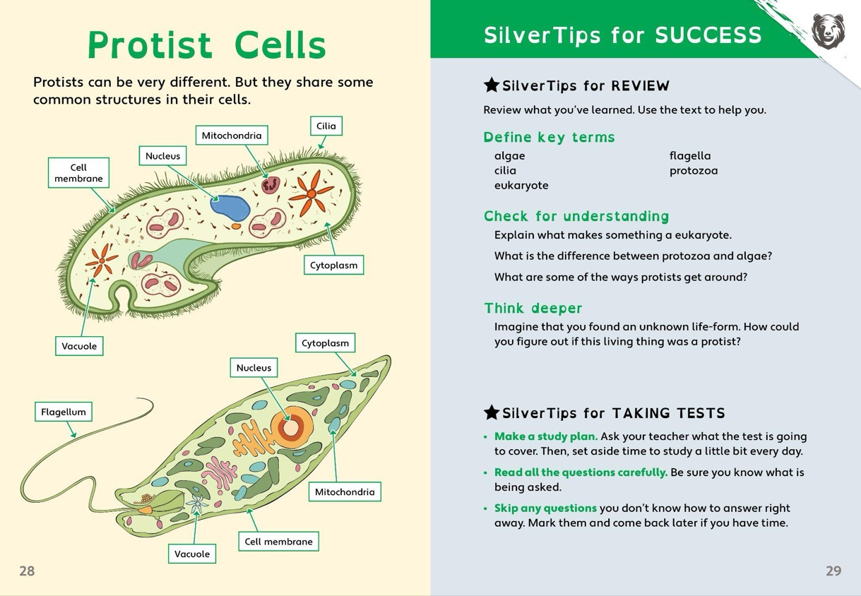
Notes:
SERIES COVERS - BELLWETHER

Slide 56
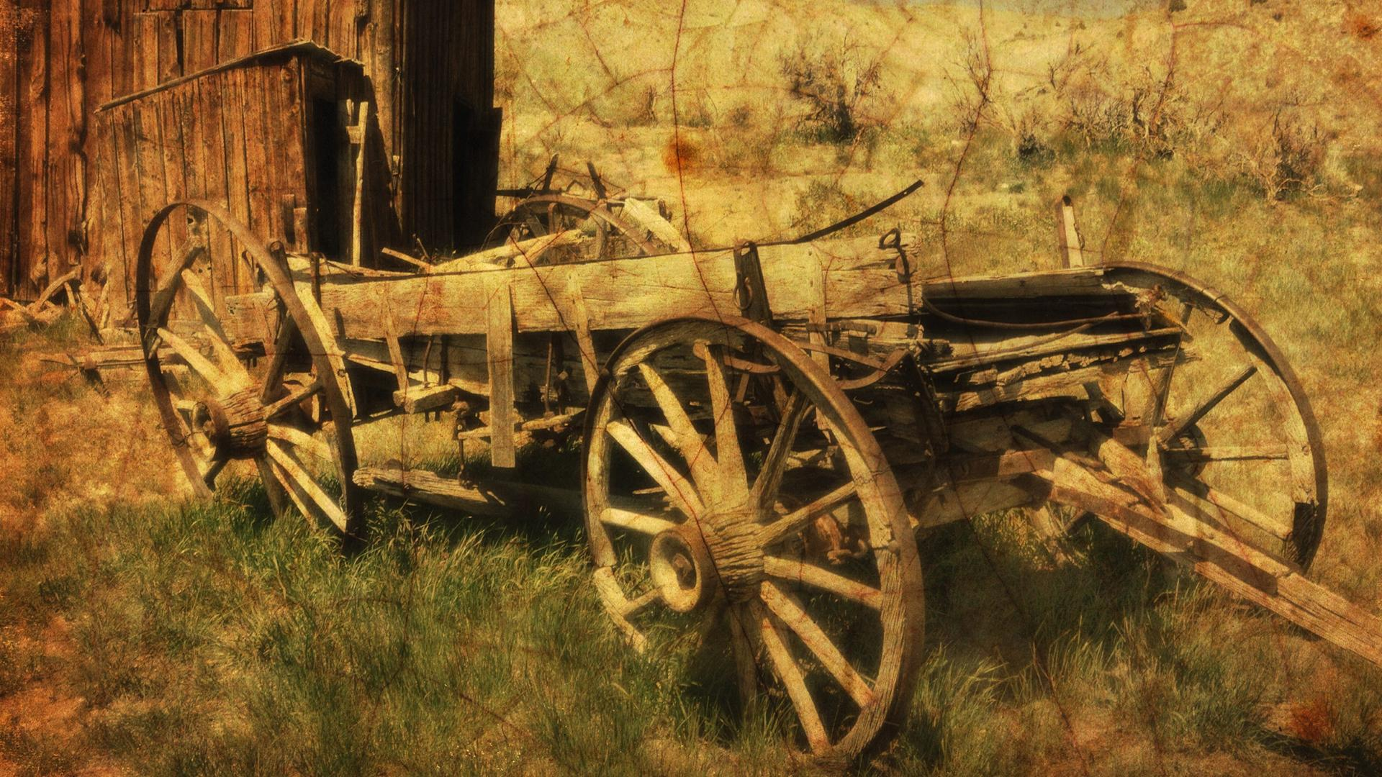






READING LEVEL: Gr. 2-3
INTEREST LEVEL: Gr. 5-7
New Series!
• Lexiles: 580L-640L
• Dyslexic-friendly font & design
• Reviewed by specialists in education
of middle school students with learning differences
• Infographics for visual learners
• SilverTips for Success section for
review & test-taking tips
Notes:
SERIES COVERS - BELLWETHER

Slide 57
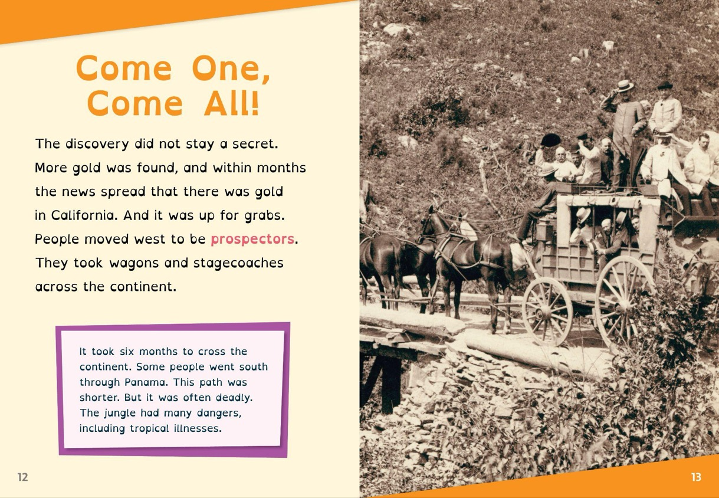
Notes:
SERIES COVERS - BELLWETHER

Slide 58
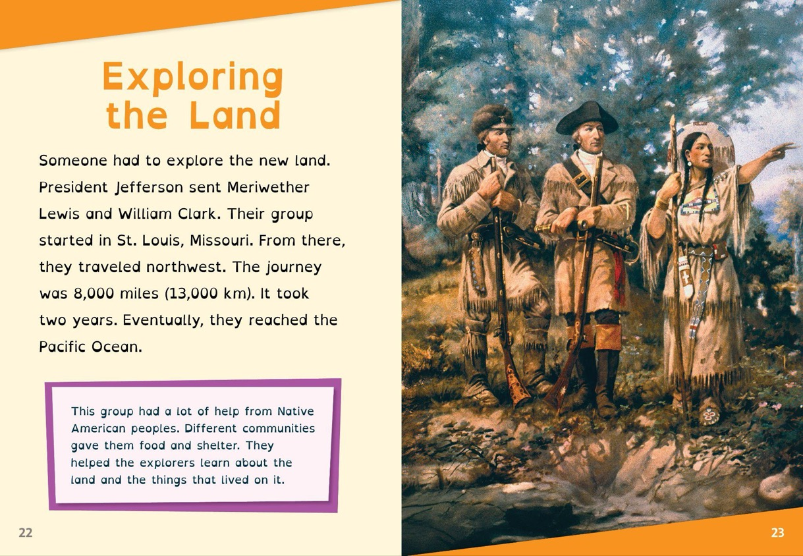
Notes:
SERIES COVERS - BELLWETHER

Slide 59
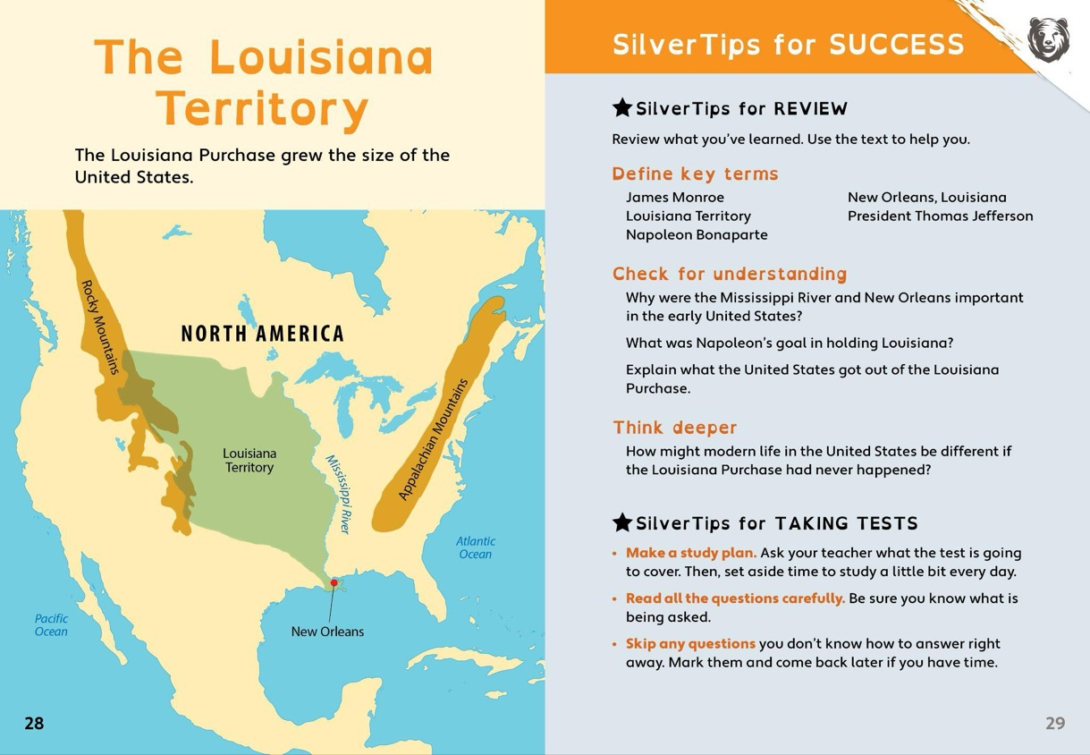
Notes:
SERIES COVERS - BELLWETHER

Slide 60


MIDDLE SCHOOL
Reading Level: Grade 6-7
Interest Level: Grades 5-8
Pages: 48
ATOS Range: 5.3-7.2
Lexile Range: 840-1170
Hardcover: $22.37
Ebook: $19.99
Notes:
IMPRINT INTRO - BELLWETHER

Slide 61







New Series!
• Lexiles: 940L-990L
• Captivating art & straightforward
explanations
• Encyclopedic-styled entries
• Breakthrough features highlight
moments & people that improved understanding of the human body
• Did You Know? Section with highly
repeatable facts
READING LEVEL: Gr. 6-7
INTEREST LEVEL: Gr. 5-8
Notes:
SERIES COVERS - BELLWETHER

Slide 62

Notes:
SERIES COVERS - BELLWETHER

Slide 63

Notes:
SERIES COVERS - BELLWETHER

Slide 64
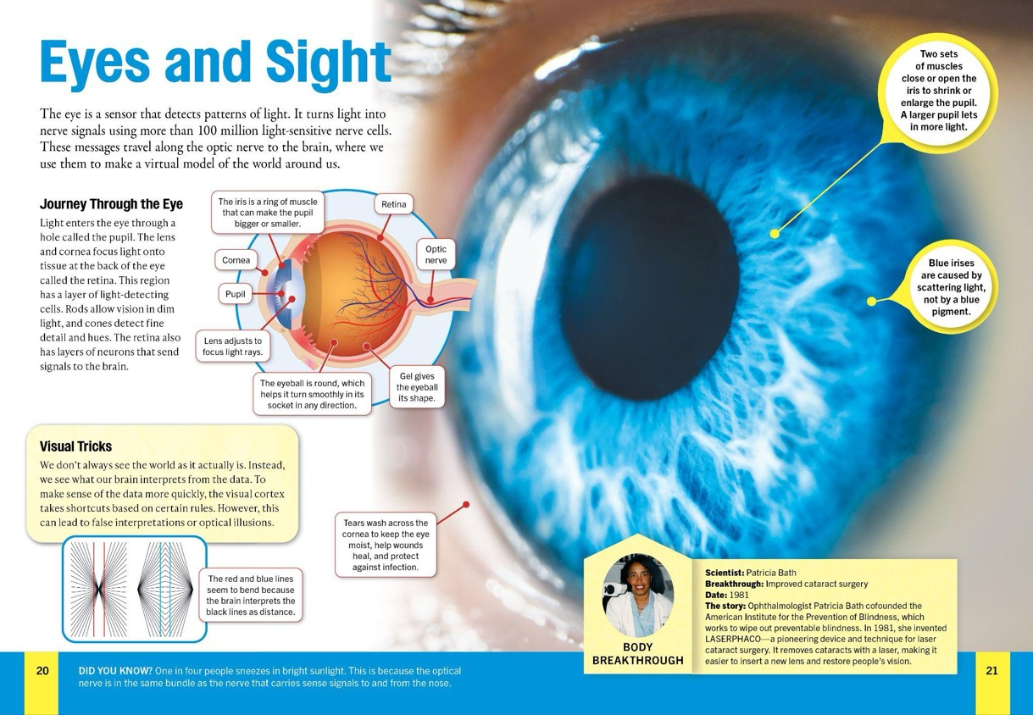
Notes:
SERIES COVERS - BELLWETHER

Slide 65



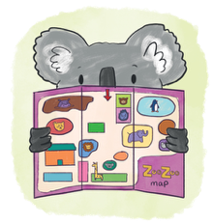



Decodable Fiction
Reading Level: Grades K-3
Interest Level: Grades K-4
Pages: 32
Hardcover: $21.67
Ebook: $19.99
Paperback: $8.99
Notes:
IMPRINT INTRO - BELLWETHER

Slide 66





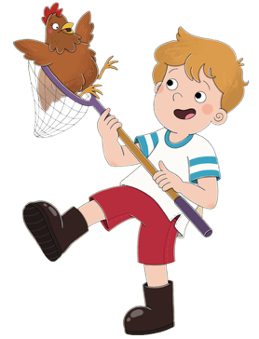
Level 1 - Pink
Set Two
4 New
Titles!
• Lexiles: 140L-200L
• Includes teaching tips and
comprehension questions
• Fun, quirky stories engage
young readers
• Introductions to simple
letter-sound combinations
READING LEVEL: Gr. K
INTEREST LEVEL: Gr. K-1
Notes:
SERIES COVERS - BELLWETHER

Slide 67
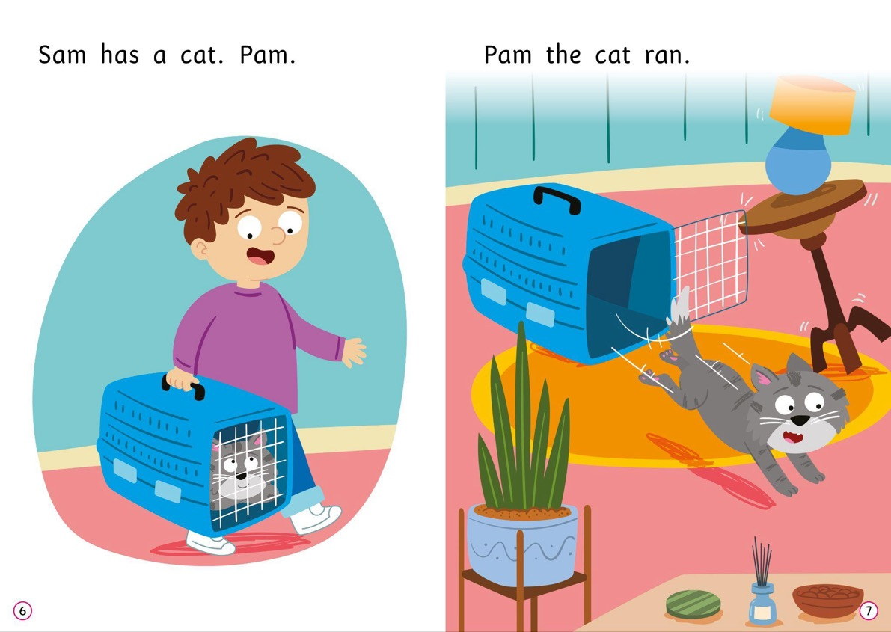
Notes:
SERIES COVERS - BELLWETHER

Slide 68
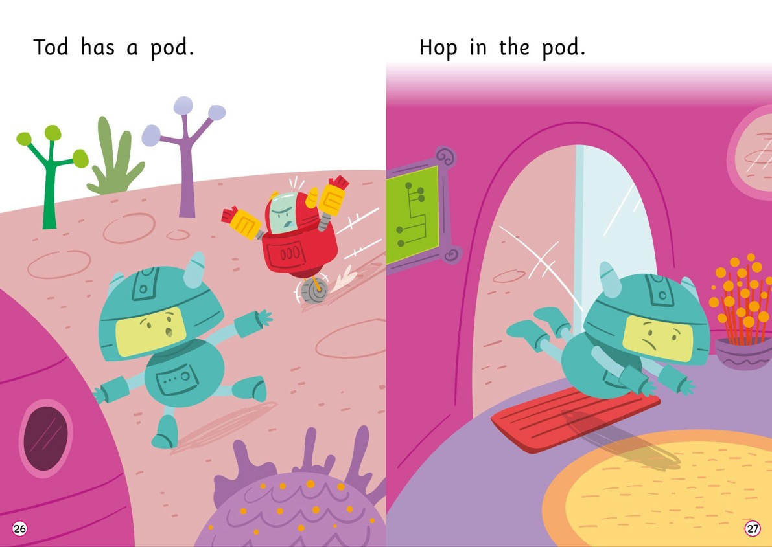
Notes:
SERIES COVERS - BELLWETHER

Slide 69
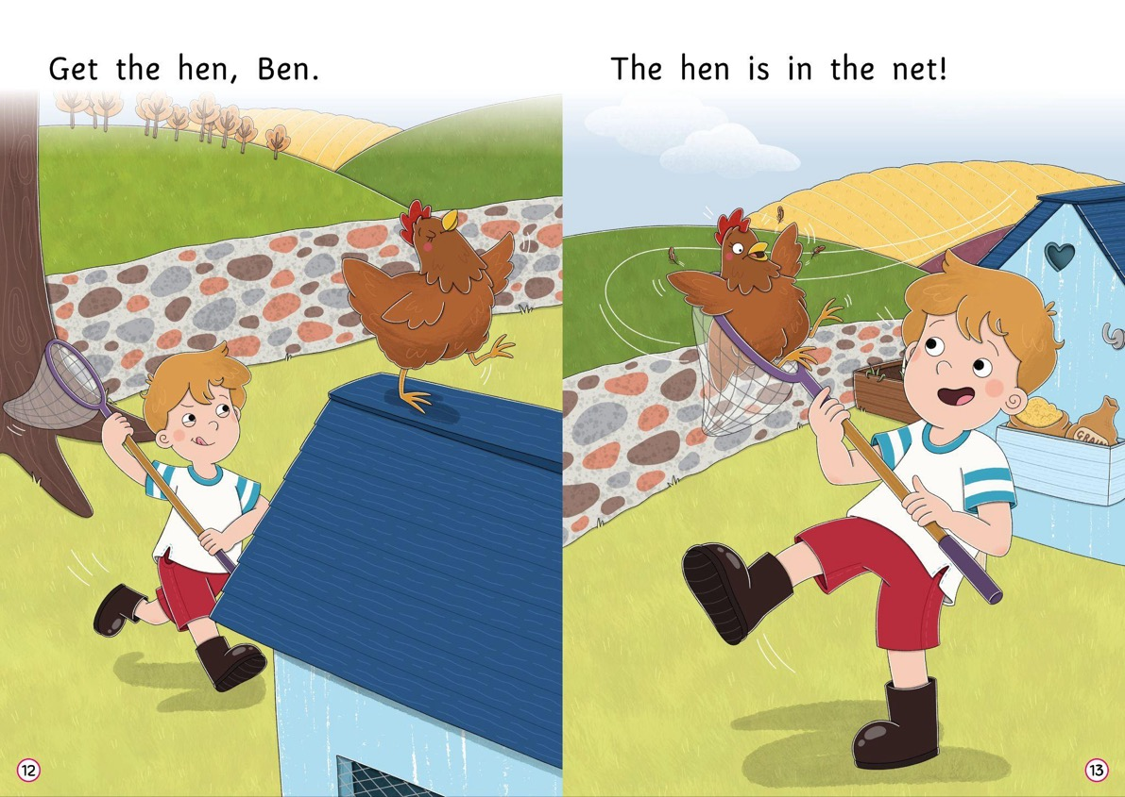
Notes:
SERIES COVERS - BELLWETHER

Slide 70





Level 2 - Red
Set Two
4 New
Titles!
• Lexiles: 210L-240L
• Includes teaching tips and
comprehension questions
• Fun, quirky stories engage
young readers
• Introductions to simple
letter-sound combinations
READING LEVEL: Gr. K-1
INTEREST LEVEL: Gr. K-2
Notes:
SERIES COVERS - BELLWETHER

Slide 71
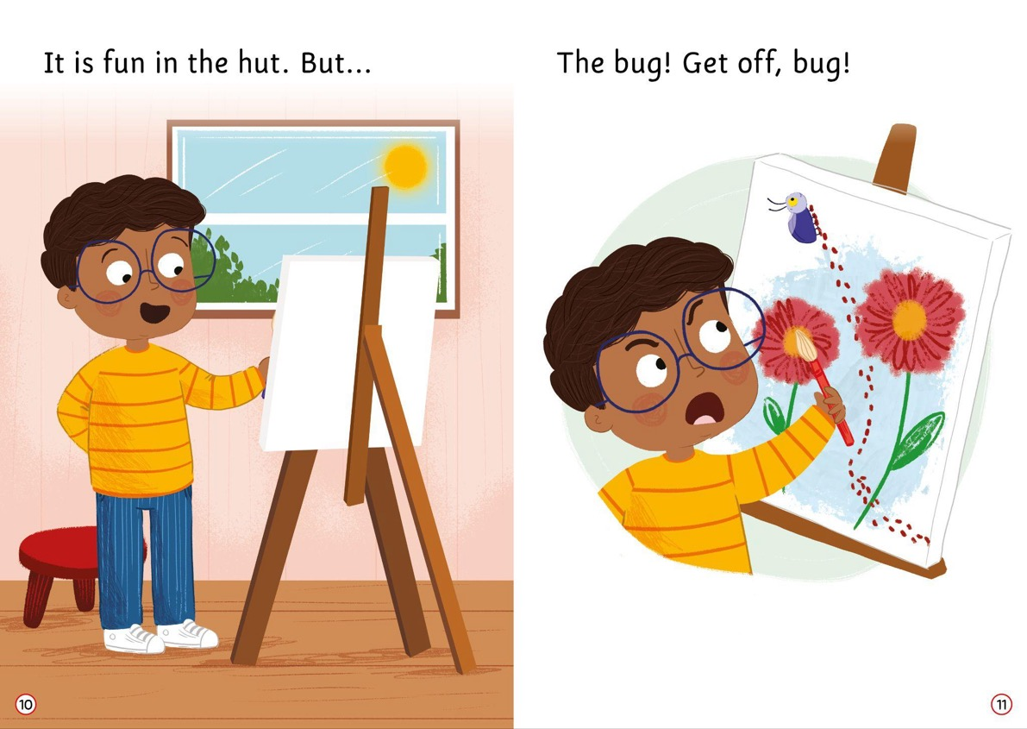
Notes:
SERIES COVERS - BELLWETHER

Slide 72
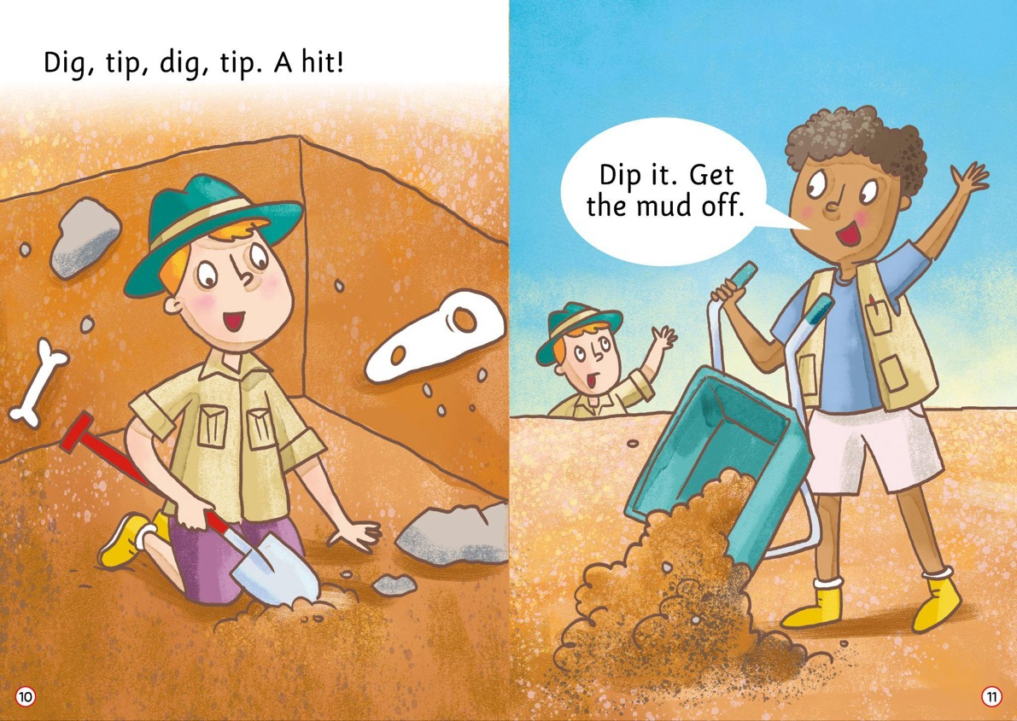
Notes:
SERIES COVERS - BELLWETHER

Slide 73

Notes:
SERIES COVERS - BELLWETHER

Slide 74





Level 3 - Yellow
Set Two
4 New
Titles!
• Lexiles: 240L-310L
• Includes teaching tips and
comprehension questions
• Fun, quirky stories engage
young readers
• Introductions to consonant
digraphs and long vowels
READING LEVEL: Gr. K-1
INTEREST LEVEL: Gr. K-2
Notes:
SERIES COVERS - BELLWETHER

Slide 75

Notes:
SERIES COVERS - BELLWETHER

Slide 76

Notes:
SERIES COVERS - BELLWETHER

Slide 77

Notes:
SERIES COVERS - BELLWETHER

Slide 78





Level 4 - Blue
Set Two
4 New
Titles!
• Lexiles: 300L-440L
• Includes teaching tips and comprehension questions
• Fun, quirky stories engage young readers
• Introductions to consonant diagraphs and long vowels
READING LEVEL: Gr. 1-2
INTEREST LEVEL: Gr. 1-3
Notes:
SERIES COVERS - BELLWETHER

Slide 79

Notes:
SERIES COVERS - BELLWETHER

Slide 80

Notes:
SERIES COVERS - BELLWETHER

Slide 81

Notes:
SERIES COVERS - BELLWETHER

Slide 82





Level 5 - Green
Set Two
4 New
Titles!
• Lexiles: 320L-480L
• Includes teaching tips and comprehension questions
• Fun, quirky stories engage young readers
• Introductions to graphemes and alternative pronunciations for known graphemes
READING LEVEL: Gr. 1-2
INTEREST LEVEL: Gr. 1-3
Notes:
SERIES COVERS - BELLWETHER

Slide 83

Notes:
SERIES COVERS - BELLWETHER

Slide 84

Notes:
SERIES COVERS - BELLWETHER

Slide 85

Notes:
SERIES COVERS - BELLWETHER

Slide 86

Notes:
SERIES COVERS - BELLWETHER

Slide 87





Level 6 - Orange
Set Two
4 New
Titles!
• Lexiles: 430L-580L
• Includes teaching tips and
comprehension questions
• Fun, quirky stories engage
young readers
• Introductions to graphemes
and alternative pronunciations
for known graphemes
READING LEVEL: Gr. 2-3
INTEREST LEVEL: Gr. 1-4
Notes:
SERIES COVERS - BELLWETHER

Slide 88

Notes:
SERIES COVERS - BELLWETHER

Slide 89

Notes:
SERIES COVERS - BELLWETHER

Slide 90

Notes:
SERIES COVERS - BELLWETHER

Slide 91

Notes:
SERIES COVERS - BELLWETHER

Slide 92


FALL 2026

Slide 93


EARLY READERS AND BEGINNING CONCEPTS
Reading Level: K
Interest Level: Grades PreK-2
ATOS Range: 0.5-1.5
Lexile Range: 150-300
Pages: 24
Hardcover: $20.97
Ebook: $19.99
Paperback: $7.99
Notes:
IMPRINT INTRO - BELLWETHER

Slide 94







New
Series!
• Lexiles coming soon!
• Simple sentences & sight words
• Labeled photos highlight each space object’s unique features
• Photo glossaries
READING LEVEL: Gr. K
INTEREST LEVEL: Gr. PreK-2
Notes:
SERIES COVERS - BELLWETHER

Slide 95

Notes:
SERIES COVERS - BELLWETHER

Slide 96











New
Series!
• Lexiles coming soon!
• Simple sentences & sight word list
• Labeled photos highlight
animals’ body parts
• Photo glossaries
READING LEVEL: Gr. K
INTEREST LEVEL: Gr. PreK-2
Notes:
SERIES COVERS - BELLWETHER

Slide 97

Notes:
SERIES COVERS - BELLWETHER

Slide 98

Notes:
SERIES COVERS - BELLWETHER

Slide 99

Notes:
SERIES COVERS - BELLWETHER

Slide 100



BUILD READING CONFIDENCE
Reading Levels:
• Level 1: Grade 1
• Level 2: Grades 1-2
• Level 3: Grades 2-3
Interest Level: Grades K-3
ATOS Range: 1.0-3.0
Lexile Range: 310-640
Pages: 24
Hardcover: $20.97
Ebook: $19.99
Paperback: $7.99
Notes:
IMPRINT INTRO - BELLWETHER

Slide 101











New
Series!
• Lexiles coming soon!
• Size charts compare different homes
• Explanation of different parts
of homes
• Labeled photos & picture glossary
READING LEVEL: Gr. 1
INTEREST LEVEL: Gr. K-3
Notes:
SERIES COVERS - BELLWETHER

Slide 102

Notes:
SERIES COVERS - BELLWETHER

Slide 103

Notes:
SERIES COVERS - BELLWETHER

Slide 104

Notes:
SERIES COVERS - BELLWETHER

Slide 105








New
Series!
• Lexiles coming soon!
• Simple text explains why
safety matters
• Features highlight safety rules
• Labeled photos & picture glossary
READING LEVEL: Gr. 1
INTEREST LEVEL: Gr. K-3
Notes:
SERIES COVERS - BELLWETHER

Slide 106

Notes:
SERIES COVERS - BELLWETHER

Slide 107

Notes:
SERIES COVERS - BELLWETHER

Slide 108

Notes:
SERIES COVERS - BELLWETHER

Slide 109










6 New Titles
• ATOS coming soon!
• Lexiles coming soon!
• Colorful, labeled photos highlight animals’ similarities & differences
READING LEVEL: Gr. 1
INTEREST LEVEL: Gr. K-3
Notes:
SERIES COVERS - BELLWETHER

Slide 110

Notes:
SERIES SPREAD 1 - BELLWETHER

Slide 111

Notes:
SERIES SPREAD 1 - BELLWETHER

Slide 112

Notes:
SERIES SPREAD 1 - BELLWETHER

Slide 113








6 New Titles!
• Lexiles coming soon!
• Maps & geographical profiles
• Facts about country’s natural
features, animals, food, and
celebrations
READING LEVEL: Gr. 1-2
INTEREST LEVEL: Gr. K-3
Notes:
SERIES COVERS - BELLWETHER

Slide 114

Notes:
SERIES COVERS - BELLWETHER

Slide 115

Notes:
SERIES COVERS - BELLWETHER

Slide 116

Notes:
SERIES COVERS - BELLWETHER

Slide 117















New
Series!
• Lexiles coming soon!
• ATOS coming soon!
• Introduce math concepts through
everyday experiences
• What Is It? photo labels
& index
READING LEVEL: Gr. 1-2
INTEREST LEVEL: Gr. K-3
Notes:
SERIES COVERS - BELLWETHER

Slide 118

Notes:
SERIES COVERS - BELLWETHER

Slide 119

Notes:
SERIES COVERS - BELLWETHER

Slide 120

Notes:
SERIES COVERS - BELLWETHER

Slide 121










New
Series!
• Lexiles coming soon!
• ATOS coming soon!
• Covers gear needed for activities
• Introduces techniques & top locations for each activity
• Photo labels, table of
contents, & glossary
READING LEVEL: Gr. 1-2
INTEREST LEVEL: Gr. K-3
Notes:
SERIES COVERS - BELLWETHER

Slide 122

Notes:
SERIES COVERS - BELLWETHER

Slide 123

Notes:
SERIES COVERS - BELLWETHER

Slide 124

Notes:
SERIES COVERS - BELLWETHER

Slide 125









6 New Titles
• Lexiles coming soon!
• ATOS coming soon!
• Explore animal life stages & food webs
• Glossary, table of contents, & index
READING LEVEL: Gr. 1-2
INTEREST LEVEL: Gr. K-3
Notes:
SERIES COVERS - BELLWETHER

Slide 126

Notes:
SERIES SPREAD 1 - BELLWETHER

Slide 127

Notes:
SERIES SPREAD 1 - BELLWETHER

Slide 128

Notes:
SERIES SPREAD 1 - BELLWETHER

Slide 129












4 New Titles
• Lexiles coming soon!
• Photo labels visually define
glossary terms and other
important words
• Sidebars show the ways in
which each career utilizes
the elements of STEM
• Profiles highlight notable
people in each career
READING LEVEL: Gr. 2-3
INTEREST LEVEL: Gr. K-3
Notes:
SERIES COVERS - BELLWETHER

Slide 130

Notes:
SERIES SPREAD 1 - BELLWETHER

Slide 131

Notes:
SERIES SPREAD 1 - BELLWETHER

Slide 132

Notes:
SERIES SPREAD 1 - BELLWETHER

Slide 133









New
Series!
• Lexiles coming soon!
• Timelines of the history of
each disease
• Explanations of how diseases
make people sick
• Diagrams of how the
illnesses can spread
READING LEVEL: Gr. 2-3
INTEREST LEVEL: Gr. K-3
Notes:
SERIES COVERS - BELLWETHER

Slide 134

Notes:
SERIES SPREAD 1 - BELLWETHER

Slide 135

Notes:
SERIES SPREAD 1 - BELLWETHER

Slide 136

Notes:
SERIES SPREAD 1 - BELLWETHER

Slide 137









New
Series!
• Lexiles coming soon!
• ATOS coming soon!
• Profiles of machines and what they do in the mines
• Labeled photos show different parts of machines
• Statistics about each machine’s capabilities
READING LEVEL: Gr. 2-3
INTEREST LEVEL: Gr. K-3
Notes:
SERIES COVERS - BELLWETHER

Slide 138

Notes:
SERIES SPREAD 1 - BELLWETHER

Slide 139

Notes:
SERIES SPREAD 1 - BELLWETHER

Slide 140

Notes:
SERIES SPREAD 1 - BELLWETHER

Slide 141

ILLUSTRATED NARRATIVE NONFICTION
Reading Level: Grades 1-2
Interest Level: Grades K-3
ATOS Range: 2.0-2.5
Lexile Range: 430-530
Pages: 24
Hardcover: $20.97
Ebook: $19.99
Notes:
IMPRINT INTRO - BELLWETHER

Slide 142









New Series!
• Lexiles coming soon!
• Follow bugs as they find food,
work on their homes, and
evade enemies
• Diagrams of bugs’ body parts
• Questions that prompt readers
to think more about text
• Mission Goals with
Blastoff Jimmy
READING LEVEL: Gr. 1-2
INTEREST LEVEL: Gr. K-3
Notes:
SERIES COVERS - BELLWETHER

Slide 143

Notes:
SERIES SPREAD 1 - BELLWETHER

Slide 144

Notes:
SERIES SPREAD 1 - BELLWETHER

Slide 145

Notes:
SERIES SPREAD 1 - BELLWETHER

Slide 146


LEARN,
EXPLORE,
DISCOVER
Reading Level: Grade 4
Interest Level: Grades 3-8
ATOS Range: 3.5-5.5
Lexile Range: 740-770
Pages: 32
Hardcover: $21.67
Ebook: $19.99
Notes:
IMPRINT INTRO - BELLWETHER

Slide 147










New
Series!
• Lexiles coming soon!
• ATOS coming soon!
• Technology & STEM Careers
• Introductions to the tools use to collect & analyze evidence
• Special features cover common challenges investigators face, statistics, & true crime case files
READING LEVEL: Gr. 4
INTEREST LEVEL: Gr. 3-8
Notes:
SERIES COVERS - BELLWETHER

Slide 148

Notes:
SERIES SPREAD 1 - BELLWETHER

Slide 149

Notes:
SERIES SPREAD 1 - BELLWETHER

Slide 150

Notes:
SERIES SPREAD 1 - BELLWETHER

Slide 151



HI ULTRA-LO
Reading Level: Grade 2
Interest Level: Grades 3-7
ATOS Range: 2.5-3.5
Lexile Range: 500-610
Pages: 24
Hardcover: $20.97
Ebook: $19.99
Notes:
IMPRINT INTRO - BELLWETHER

Slide 152








4 New Titles
• Lexiles coming soon!
• ATOS coming soon!
• Range maps of U.S. game habitats
• Favorite Spots sidebars show where to find game
• Infographics of gear needed for a hunt
• Hunting safety facts
READING LEVEL: Gr. 2
INTEREST LEVEL: Gr. 3-7
Notes:
SERIES COVERS - BELLWETHER

Slide 153

Notes:
SERIES COVERS - BELLWETHER

Slide 154

Notes:
SERIES COVERS - BELLWETHER

Slide 155

Notes:
SERIES COVERS - BELLWETHER

Slide 156









New
Series!
• Lexiles coming soon!
• Introduce each park’s
history, current operations, and fans
• Profiles on each park’s
main attraction
• Attendance record charts
READING LEVEL: Gr. 2
INTEREST LEVEL: Gr. 3-7
Notes:
SERIES COVERS - BELLWETHER

Slide 157

Notes:
SERIES COVERS - BELLWETHER

Slide 158

Notes:
SERIES COVERS - BELLWETHER

Slide 159

Notes:
SERIES COVERS - BELLWETHER

Slide 160












New
Series!
• Lexiles coming soon!
• Learn about popular places to
practice each sport
• Profiles on famous athletes
• Approachable explanations
of tricks & techniques
READING LEVEL: Gr. 2
INTEREST LEVEL: Gr. 3-7
Notes:
SERIES COVERS - BELLWETHER

Slide 161

Notes:
SERIES COVERS - BELLWETHER

Slide 162

Notes:
SERIES COVERS - BELLWETHER

Slide 163

Notes:
SERIES COVERS - BELLWETHER

Slide 164


HI-LO
Reading Level: Grade 3
Interest Level: Grades 3-7
ATOS Range: 3.0-5.0
Lexile Range: 550-760
Pages: 24
Hardcover: $20.97
Paperback: $8.99
Ebook: $19.99
Notes:
IMPRINT INTRO - BELLWETHER

Slide 165









4 New Titles
• ATOS coming soon!
• Lexiles coming soon!
• Comparisons of animals’ weapons and strategies
• Action-packed narrative fight scene
READING LEVEL: Gr. 3
INTEREST LEVEL: Gr. 3-7
Notes:
SERIES COVERS - BELLWETHER

Slide 166

Notes:
SERIES SPREAD 1 - BELLWETHER

Slide 167

Notes:
SERIES SPREAD 1 - BELLWETHER

Slide 168

Notes:
SERIES SPREAD 1 - BELLWETHER

Slide 169







New
Series!
• Lexiles coming soon!
• ATOS coming soon!
• Follow famous wrestlers’ rise through the ranks
• Wrestler stats & awards
• Profiles of each wrestler’s favorite things
READING LEVEL: Gr. 3
INTEREST LEVEL: Gr. 3-7
Notes:
SERIES COVERS - BELLWETHER

Slide 170

Notes:
SERIES SPREAD 1 - BELLWETHER

Slide 171

Notes:
SERIES SPREAD 1 - BELLWETHER

Slide 172

Notes:
SERIES SPREAD 1 - BELLWETHER

Slide 173


GRAPHIC NARRATIVE NONFICTION
Reading Level: Grade 3-4
Interest Level: Grades 3-8
Lexile Range: 500-740
Pages: 24
Hardcover: $23.07
Ebook: $19.99
Notes:
IMPRINT INTRO - BELLWETHER

Slide 174









New
Series!
• Lexiles coming soon!
• Follow archeologists as they unearth hidden tombs, ancient heists, and more
• Narrative nonfiction text
• Original illustrations
• Maps of sites and historical timelines
READING LEVEL: Gr. 3-4
INTEREST LEVEL: Gr. 3-8
Notes:
SERIES COVERS - BELLWETHER

Slide 175

Notes:
SERIES SPREAD 1 - BELLWETHER

Slide 176

Notes:
SERIES SPREAD 1 - BELLWETHER

Slide 177

Notes:
SERIES SPREAD 1 - BELLWETHER

Slide 178


HIGH-INTEREST MIDDLE SCHOOL
Reading Level: Grades 3-4
Interest Level: Grades 5-8
ATOS Range: 5.0-6.5
Lexile Range: 780-1010
Pages: 48
Hardcover: $22.37
Ebook: $19.99
Notes:
IMPRINT INTRO - BELLWETHER

Slide 179







4 New Titles
• Lexiles coming soon!
• Full spread illustrates animal family tree
• Taxonomy charts
• Evolutionary adaptations
• Size comparison feature
READING LEVEL: Gr. 3-4
INTEREST LEVEL: Gr. 5-8
Notes:
SERIES COVERS - BELLWETHER

Slide 180

Notes:
SERIES SPREAD 1 - BELLWETHER

Slide 181

Notes:
SERIES SPREAD 1 - BELLWETHER

Slide 182

Notes:
SERIES SPREAD 1 - BELLWETHER

Slide 183








New Series!
• Lexiles coming soon!
• ATOS coming soon!
• Introduce each genre’s history
& subgenres
• Profiles on notable artists
• Hit releases, timelines, &
instrument profiles
READING LEVEL: Gr. 3-4
INTEREST LEVEL: Gr. 5-8
Notes:
SERIES COVERS - BELLWETHER

Slide 184

Notes:
SERIES SPREAD 1 - BELLWETHER

Slide 185

Notes:
SERIES SPREAD 1 - BELLWETHER

Slide 186

Notes:
SERIES SPREAD 1 - BELLWETHER

Slide 187



FALL 2026
Notes:
PUBLISHER INTRO - JUMP

Slide 188


NONFICTION DECODABLE READERS
Reading Level: Grades PreK-K
Interest Level: Grades PreK-1
ATOS Range: 0.5-0.9
Lexile Range: BR20-170L
Pages: 16
Hardcover: $19.59
Ebook: $19.99
Paperback: $7.99
Notes:
IMPRINT INTRO - BELLWETHER

Slide 189






New Series!
• Lexiles: 110L-170L
• Alphabet letter placement
• Real-life photos reinforce each
target letter sound
• Teaching Tips guide instruction
• Interactive letter tracing exercises
READING LEVEL: Gr. PreK
INTEREST LEVEL: Gr PreK-1
Notes:
IMPRINT INTRO - BELLWETHER

Slide 190


























Notes:
IMPRINT INTRO - BELLWETHER

Slide 191


Notes:
SERIES SPREAD 1 - BEARPORT

Slide 192

Notes:
SERIES SPREAD 1 - BEARPORT

Slide 193

Notes:
SERIES SPREAD 1 - BEARPORT

Slide 194



BEGINNING READERS
Reading Level: Grades PreK-K
Interest Level: Grades PreK-1
ATOS Range: 0.5-0.9
Lexile Range: BR20-170L
Pages: 16
Hardcover: $20.29
Ebook: $19.99
Paperback: $7.99
Notes:
IMPRINT INTRO - BELLWETHER

Slide 195









New Series!
• Lexiles: 160L-250L
• Clear, relatable examples to help readers learn about time
• Teaching tools for caregivers
• Words to Know & index
• Let’s Review! section
READING LEVEL: Gr. PreK
INTEREST LEVEL: Gr PreK-1
Notes:
IMPRINT INTRO - BELLWETHER

Slide 196

Notes:
SERIES SPREAD 1 - BEARPORT

Slide 197



Notes:
SERIES SPREAD 1 - BEARPORT

Slide 198









LET’S GO TO SCHOOL!
New Series!
• Lexiles: 30L-230L
• Helps prepare the earliest readers for school
• Teaching tools for caregivers
• Words to Know & index
• Let’s Review! section
READING LEVEL: Gr. PreK
INTEREST LEVEL: Gr PreK-1
Notes:
SERIES COVERS - BELLWETHER

Slide 199

Notes:
SERIES SPREAD 1 - BEARPORT

Slide 200




EARLY READERS AND BEGINNING CONCEPTS
Reading Level: Grade K
Interest Level: Grades K-3
ATOS Range: 0.5-1.5
Lexile: 100L-400L
Pages: 24
Hardcover: $20.99
Ebook: $19.99
Paperback: $7.99
Notes:
IMPRINT INTRO - BELLWETHER

Slide 201










All in Fall
New Series!
• ATOS coming soon!
• Lexiles: 240L-300L
• Picture glossary
• Photo labels
• Hands-on crafts & activities
• Table of contents & index
READING LEVEL: Gr. K
INTEREST LEVEL: Gr. K-3
Notes:
SERIES COVERS - BELLWETHER

Slide 202


Notes:
SERIES SPREAD 2 - BEARPORT

Slide 203


Notes:
SERIES SPREAD 2 - BEARPORT

Slide 204


Notes:
SERIES SPREAD 2 - BEARPORT

Slide 205








Hello, Reptiles!
New Series!
• Lexiles: 210L-330L
• Photos with body parts labeled
• Introductions to reptiles’
behaviors & habitats
• Picture glossary
• Table of contents & index
READING LEVEL: Gr. K
INTEREST LEVEL: Gr. K-3
Notes:
SERIES COVERS - BELLWETHER

Slide 206

Notes:
SERIES SPREAD 1 - BEARPORT

Slide 207


Notes:
SERIES SPREAD 2 - BEARPORT

Slide 208









Spot the Differences
New Series!
• Lexiles: 250L-290L
• Picture glossary & labels
• Details about animals’
habitats, behavior, and
appearance
• Activity asks readers to
determine which animal
is which
READING LEVEL: Gr. K
INTEREST LEVEL: Gr. K-3
Notes:
SERIES COVERS - BELLWETHER

Slide 209

Notes:
SERIES SPREAD 1 - BEARPORT

Slide 210

Notes:
SERIES SPREAD 1 - BEARPORT

Slide 211

Notes:
SERIES SPREAD 1 - BEARPORT

Slide 212





ILLUSTRATED FICTION & NARRATIVE NONFICTION
Three Reading Levels:
Level 1: Grades PreK-K
Level 2: Grade 1
Level 3: Grade 2
Interest Level: Grades PreK-5
ATOS Range: 0.5-3.5
Lexile Range: 230L-560L
Pages: 16-24
Hardcover: $20.99
Ebook: $19.99
Paperback: $7.99
Notes:
IMPRINT INTRO - BELLWETHER

Slide 213






MEET THE COMMUNITY HELPERS!
Level 2
4 New Titles
• Lexiles: 340L-480L
• Introduces each professional’s work setting, uniform, responsibilities, & tools
•Let’s Review! section
• Picture glossary
• Tools for teachers and caregivers
READING LEVEL: Gr. 1
INTEREST LEVEL: Gr. 1-2
Notes:
SERIES COVERS - BELLWETHER

Slide 214

Notes:
SERIES SPREAD 1 - BEARPORT

Slide 215

Notes:
SERIES SPREAD 1 - BEARPORT

Slide 216

Notes:
SERIES SPREAD 1 - BEARPORT

Slide 217







FOLK LEGENDS
Level 3
4
New Titles
• ATOS coming soon!
• Lexiles: 450L-510L
• Illustrated snapshots of popular folk legends
• Glossary & index
• Tools for teachers & caregivers
• Maps
READING LEVEL: Gr. 2
INTEREST LEVEL: Gr. 2-5
Notes:
SERIES COVERS - BELLWETHER

Slide 218

Notes:
SERIES SPREAD 1 - BEARPORT

Slide 219

Notes:
SERIES SPREAD 1 - BEARPORT

Slide 220

Notes:
SERIES SPREAD 1 - BEARPORT

Slide 221







KNOWLEDGE BUILDING
STEM & Social Studies Topics
Reading Level: Grade 2
Interest Level: Grades 2-5
ATOS Range: 2.5-3.5
Lexile Range: 430-560L
Pages: 24
Hardcover: $20.99
Ebook: $19.99
Paperback: $7.99
Notes:
IMPRINT INTRO - BELLWETHER

Slide 222















HOLIDAY HISTORY
6 New Titles!
• Lexiles: 420L-520L
• Introduces backgrounds of popular holidays & celebrations
• Builds awareness of cultural & environmental changes
• “At a Glance” quick facts charts & map
• Ideas for parents & teachers
READING LEVEL: Gr. 2
INTEREST LEVEL: Gr. 2-5
Notes:
SERIES COVERS - BELLWETHER

Slide 223

Notes:
SERIES SPREAD 1 - BEARPORT

Slide 224

Notes:
SERIES SPREAD 1 - BEARPORT

Slide 225


Notes:
SERIES SPREAD 1 - BEARPORT

Slide 226










OUR CHANGING
WORLD
New Series!
• Lexiles: 450L-500L
• ATOS coming soon!
• Introduce the ways our world changes over time
• Visual comparisons show
changes over time
• Activities & experiments
READING LEVEL: Gr. 2
INTEREST LEVEL: Gr. 2-5

Slide 227


Slide 228


Slide 229


Slide 230










SCIENCE BEHIND THE COLORS
6 New
Titles!
• Lexiles: 460L-500L
• ATOS coming soon!
• Learn how & why some animals get their distinctive colors
• Activities & experiments
• Labeled diagrams, infographics, & sidebars
READING LEVEL: Gr. 2
INTEREST LEVEL: Gr. 2-5

Slide 231


Slide 232


Slide 233


Slide 234





FALL 2026
Notes:
PUBLISHER INTRO - KALEIDOSCOPE

Slide 235


CLEVER, QUIRKY PICTURE BOOKS
Reading Level: Grades 1-2
Interest Level: Grades K-3
ATOS Range: 2.5-3.5
Lexile Range: 480-550
Pages: 32
Hardcover: $30.95
Ebook: $19.99
Paperback: $9.99
Notes:
IMPRINT INTRO - BELLWETHER

Slide 236









New Series!
• ATOS coming soon!
• Lexiles coming soon!
• Picture-perfect books for
autumn read-alouds
• Just the right amount of
scary & silly for young readers
• Perfect for fans of Creepy
Carrots and The Bad Seed
READING LEVEL: Gr. 2-3
INTEREST LEVEL: Gr. K-3

Slide 237


Slide 238


Slide 239




2
New Titles
• ATOS coming soon!
• Lexiles coming soon!
• “These truly funny books are packed with flavor and substance!” – SLJ
• Highlights SEL topics such as anger management and understanding differences
• Back matter includes activity to make your own puns
READING LEVEL: Gr. 1-2
INTEREST LEVEL: Gr. K-3

Slide 240


Slide 241


Slide 242

CHEERY, CHEEKY EARLY CHAPTER BOOKS
Reading Level: Grades 1-3
Interest Level: Grades K-3
Pages: 64
Hardcover: $32.95
Ebook: $19.99
Paperback: $10.99
Notes:
IMPRINT INTRO - BELLWETHER

Slide 243








New Series!
• ATOS coming soon!
• Lexiles coming soon!
• Serialized story spans four books
• Adorable cat main character who defies expectations
• Lighthearted, funny fantasy stories
• Themes of perseverance and friendship.
READING LEVEL: Gr. 1-2
INTEREST LEVEL: Gr. K-3

Slide 244


Slide 245


Slide 246


Slide 247

MIDDLE GRADE CHAPTER BOOKS
WITH A MIX OF HUMOR, ACTION & HEART
Reading Level: Grades 3-4
Interest Level: Grades 2-5
Pages: 88
Hardcover: $32.95
Ebook: $19.99
Paperback: $10.99
Notes:
IMPRINT INTRO - BELLWETHER

Slide 248








New Series!
• Available Oct. 1
• ATOS coming soon!
• Lexiles coming soon!
• Serialized story spans four books
• Just right scary series for fans of
creepy tales and ghost hunting
• Features themes of bravery and
exploration of the unknown
• Relatable characters in
extraordinary situations
READING LEVEL: Gr. 3-4
INTEREST LEVEL: Gr. 2-5

Slide 249


Slide 250


Slide 251






New Series!
• ATOS coming soon!
• Lexiles coming soon!
• Fun fantasy series for all children
• Themes of managing sibling dynamics
• Themes of teamwork and appreciation
READING LEVEL: Gr. 3-4
INTEREST LEVEL: Gr. 2-5

Slide 252


Slide 253


Slide 254










4
New
Titles!
• Lexiles coming soon!
• Fast-paced stories in easy-to-read chapter books
• Explores themes of teamwork,
bullying, fitting in, and equity
• Back matter includes profiles
of real athletes, discussion
questions, and writing prompts
READING LEVEL: Gr. 3-4
INTEREST LEVEL: Gr. 2-5

Slide 255


Slide 256


Slide 257


Slide 258





New
Series!
• Lexiles coming soon!
• Fun, fast-paced action series set in space
• Celebrates quick thinking and curiosity
• For fans of Minecraft, Roblox, and Trapped in a Video Game
READING LEVEL: Gr. 3-4
INTEREST LEVEL: Gr. 2-5

Slide 259


Slide 260


Slide 261






New
Series!
• Lexiles coming soon!
• Story follows Rafa as he forges his own path among the stars
• Fun, fast-paced action series set in space
• Celebrates quick thinking and curiosity
READING LEVEL: Gr. 3-4
INTEREST LEVEL: Gr. 2-5

Slide 262


Slide 263


Slide 264

GRAPHIC NOVELS
BURSTING WITH HEROES AND HIJINKS!
Reading Level: Grades 1-3
Interest Level: Grades K-3
Lexile Range: 290-600
Pages: 32-64
Hardcover: $32.95
Ebook: $19.99
Paperback: $10.99
Notes:
IMPRINT INTRO - KALEIDOSCOPE

Slide 265








New
Series!
• Lexiles coming soon!
• Frankie the crab navigates life in his own unique way
• Celebrates individuality and
understanding differences
• Full-color, comic-style art
supports comprehension
READING LEVEL: Gr. 1-2
INTEREST LEVEL: Gr. K-3

Slide 266


Slide 267


Slide 268






New Series!
• Lexiles coming soon!
• Make it Lovecraftian but cute
• Features themes of friendship and loyalty
• Comic-style illustrations aid comprehension
READING LEVEL: Gr. 1-2
INTEREST LEVEL: Gr. K-3

Slide 269


Slide 270


Slide 271


Slide 272







New
Series!
• Lexiles coming soon!
• ATOS coming soon!
• Winks to classic noir themes and the staple hard-boiled detective
• Simple, funny, kid-friendly mysteries
• Comic-style art aids comprehension
READING LEVEL: Gr. 1-2
INTEREST LEVEL: Gr. K-3

Slide 273


Slide 274


Slide 275







New
Series!
• ATOS coming soon!
• Lexiles coming soon!
• Blends school-day challenges with high-stakes superhero missions
• Full-color, comic-style art supports comprehension
• Combination of comic art and text bridges chapter books and graphic novels
READING LEVEL: Gr. 1-2
INTEREST LEVEL: Gr. K-3

Slide 276


Slide 277


Slide 278


Slide 279







New Series!
• Lexiles coming soon!
• ATOS coming soon!
• Features creativity and sibling dynamics
• Full-color, comic-style art supports comprehension
• Combination of comic art and text bridges chapter books and graphic novels
READING LEVEL: Gr. 1-2
INTEREST LEVEL: Gr. K-3

Slide 280


Slide 281


Slide 282

A BLEND OF FICTION & NONFICTION
Reading Level: Grades 2-4
Interest Level: Grades K-5
Lexile Range: 360-870
Pages: 48
Hardcover: $32.95
Ebook: $19.99
Notes:
IMPRINT INTRO - BELLWETHER

Slide 283








4
New Titles
• Lexiles coming soon!
• This season, Bigfoot explores some of history’s spookiest locations
• Fiction story paired with nonfiction sidebars
• Interactive scavenger hunt throughout
CHAPTER BOOKS
READING LEVEL: Gr. 1-2
INTEREST LEVEL: Gr. K-3

Slide 284


Slide 285


Slide 286







New
Series!
• Lexiles coming soon!
• Perfect for fans of survival stories
• Fiction and nonfiction together
for a sustained reading experience
• Full-color, sophisticated, browsable
design perfect for reluctant readers
READING LEVEL: Gr. 3-4
INTEREST LEVEL: Gr. 2-5

Slide 287


Slide 288


